Slide 1
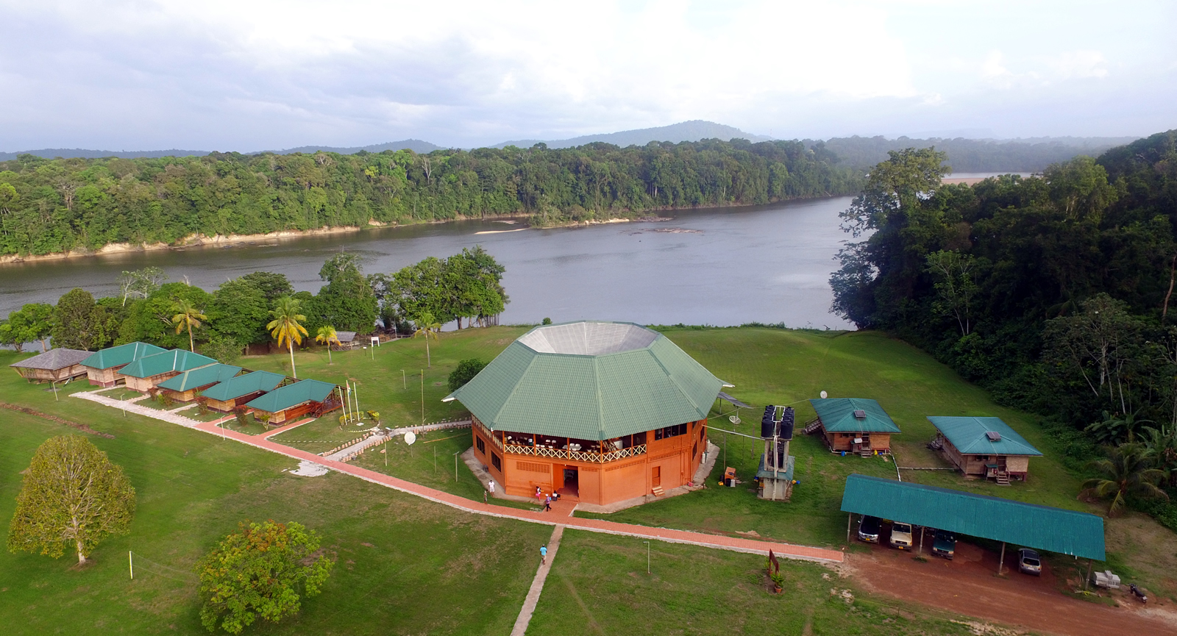
Exploring the Heart of Guyana: The Iwokrama Forest Reserve
Case Study 1

Slide 2
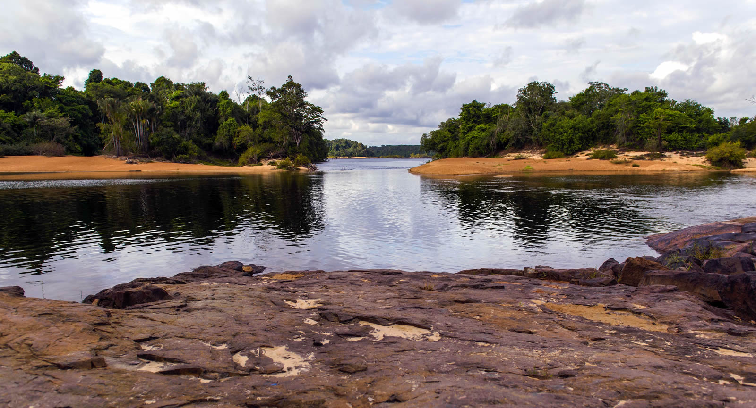
Table of Contents
Background
Study Area
Rationale
Sustainability Assessment
Environmental
Economic
Institutional/Political
Socio-cultural
Limitations
References

Slide 3
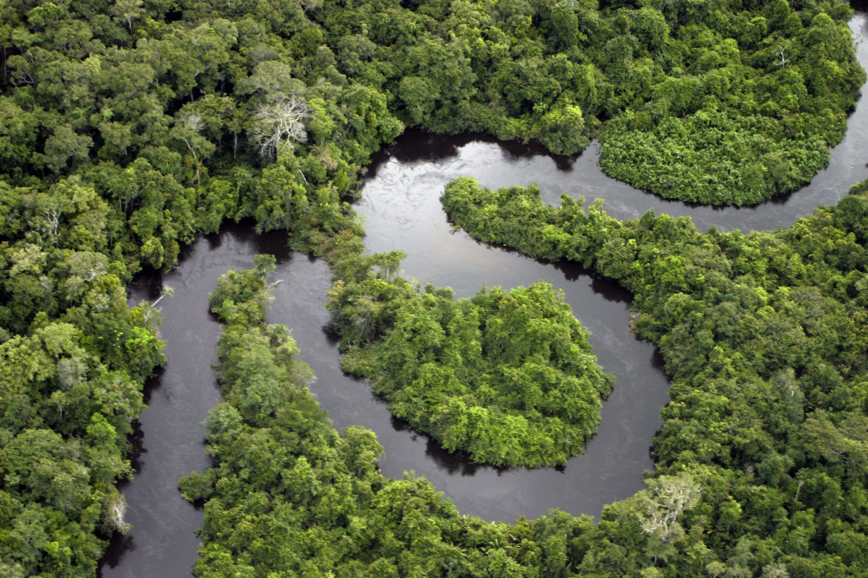
Background
Located in Guyana, South America
Over 85% of Guyana's land is covered in lush rainforests
Guyana "gifted" 371,000 hectares to the international community

Slide 4
Background
Iwokrama comes from the local Makushi tribe language meaning "place of refuge."
The forest comprises 371,000 hectares of rainforests, and was established in 1996
Managed by International Iwokrama Centre (IIC)
Population South of the Iwokrama Forest: 7,000 in 20 villages
Population Northwest of the Iwokrama Forest: < 10,000 in region 8

Slide 5
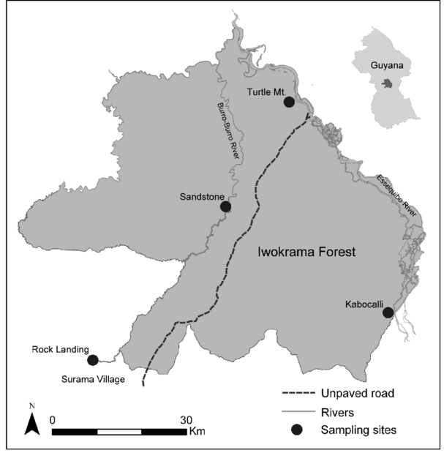
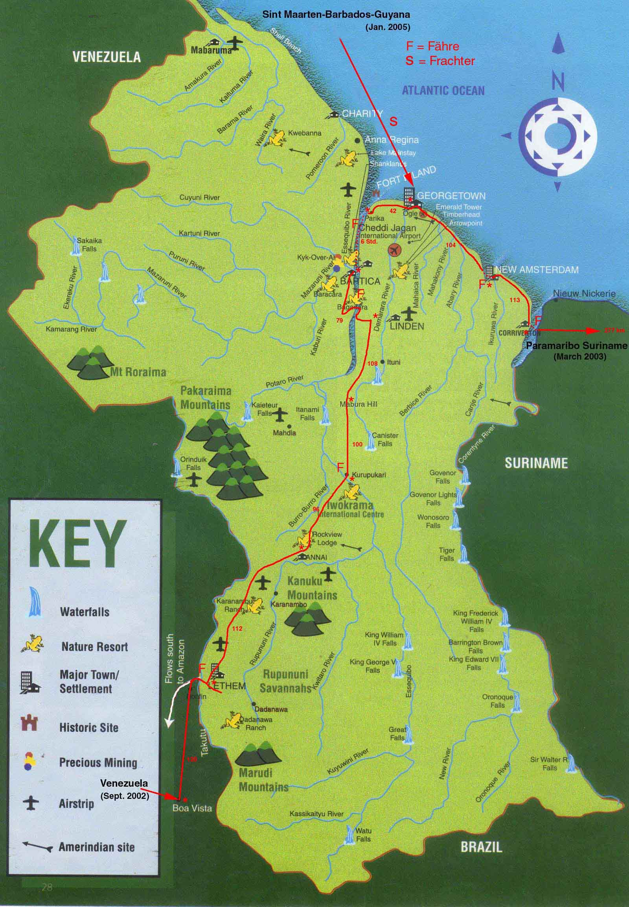
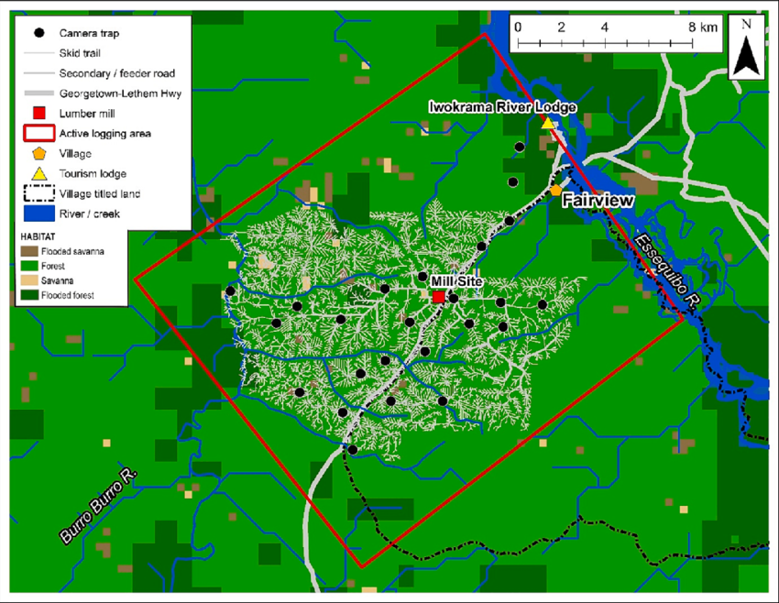
Study Area
Notes:
I have also added them at the end
Image References:
Horsley, T., Bicknell, J., Lim, B., & Ammerman, L. (2015). Seed Dispersal by Frugivorous Bats in Central Guyana and a Description of Previously Unknown Plant-Animal Interactions. Acta Chiropterologica, 17, 331-336. https://doi.org/10.3161/15081109ACC2015.17.2.008
N.D. Enjoy some pictures of the worldrecordtour, taken in Guyana - Part 2: Iwokrama. http://weltrekordreise.ch/p_amerise_gy2.html
Harris, A.-E., Hallett, M., Davis, M., Carter, M., Singh, D., Roopsind, A., Maharaj, G., & Bicknell, J. (2023). Use of logging roads by terrestrial mammals in a responsibly managed neotropical rainforest in Guyana. Forest Ecology and Management, 548, 121401. https://doi.org/10.1016/j.foreco.2023.121401

Slide 6
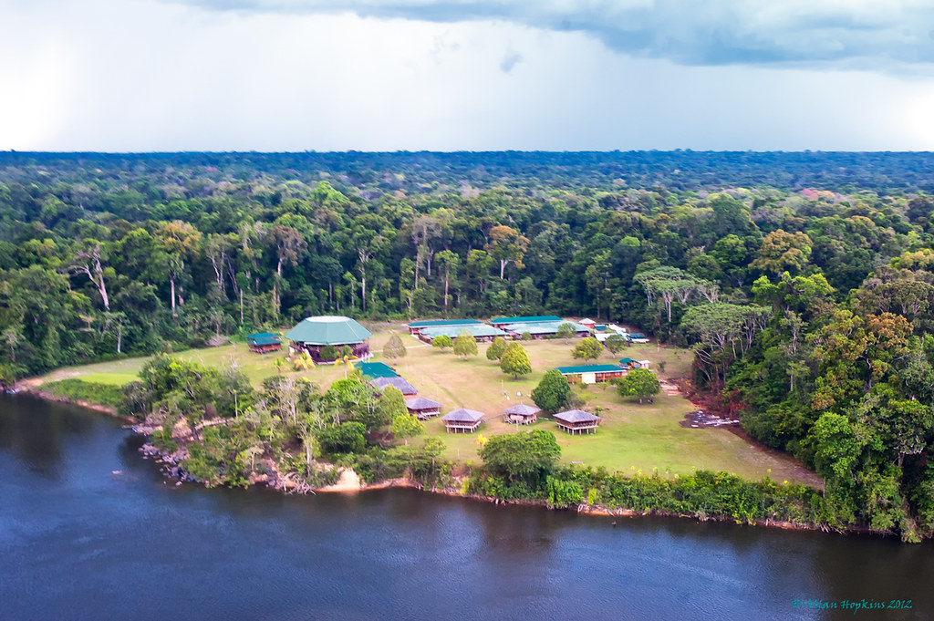
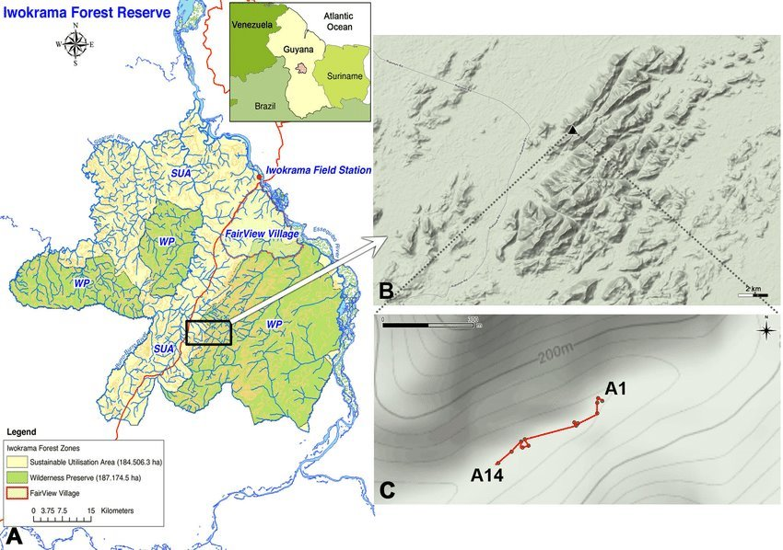
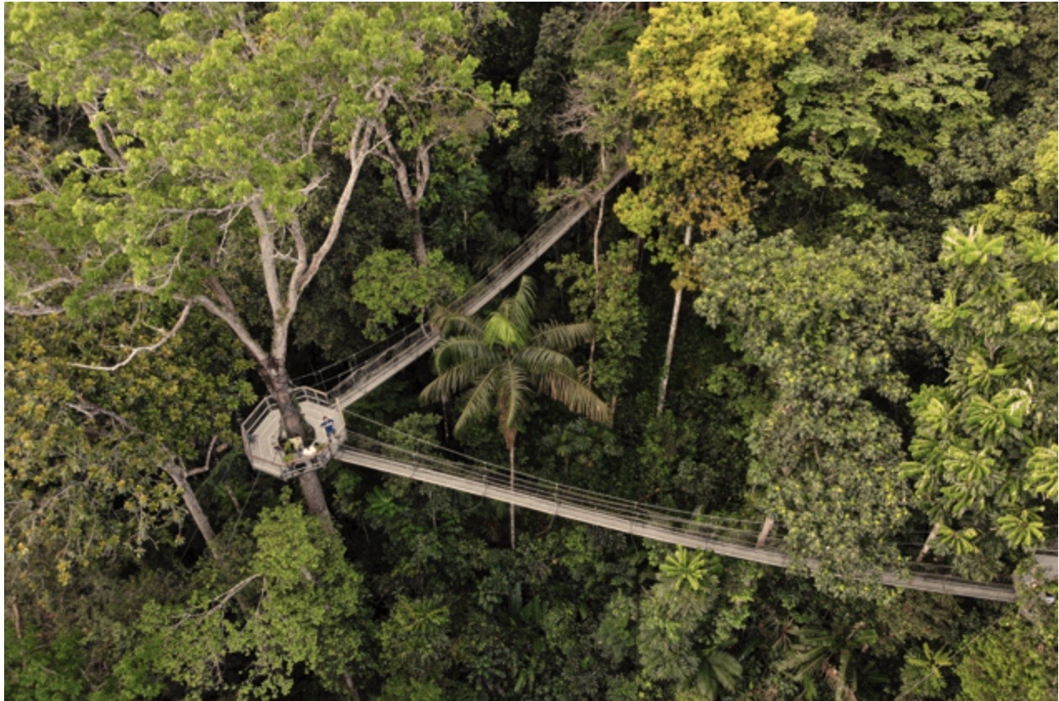
Founded in 1996 as a joint mandate of the Government of Guyana and the Commonwealth secretariat
Received award for Top 100 Green Destination stories
Notes:
I have also added them at the end
Image References:
Hok, P. J. R. (2011). A new species of the genus Gonatodes Fitzinger, 1843 (Reptilia: Sphaerodactylidae) from central Guyana, northern South America. Zootaxa, 3018(3018), 1-12. https://doi.org/10.11646/zootaxa.3018.1.1
Triplyzer. (2023). 30 Famous Landmarks in Guyana – you shouldn't be missing. Triplyzer. Retrieved from https://triplyzer.com/landmarks/south-america-landmarks/landmarks-in-guyana/
iNews Guyana. (2022, December 7). Iwokrama welcomes Guyana’s innovative Carbon Agreement. iNews Guyana. https://www.inewsguyana.com/iwokrama-welcomes-guyanas-innovative-carbon-agreement/

Slide 7
Rationale
Guyana is one of the few developing countries which has limited deforestation and has prioritized conservation.
Partnership with Norway since 2009, has earned Guyana 220 million USD
Iwokrama highlights this dedication to sustainability as it is one of the last four remaining pristine tropical forests in the world
Iwokrama Nature Reserve has been featured in the Top 100 Green Destinations Stories for 2022
Model for future sustainable tourism?

Slide 8
4.1 Environment

Slide 9
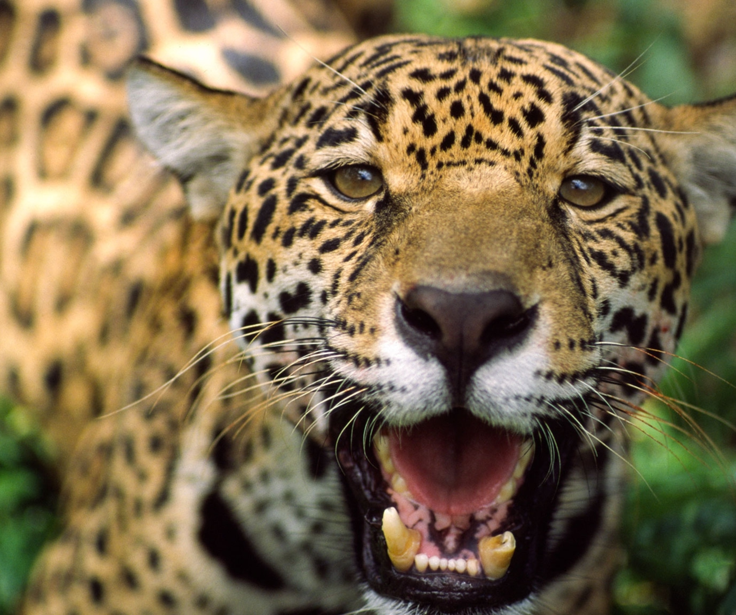
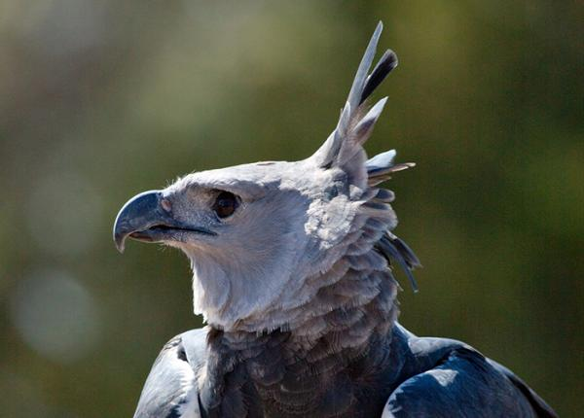
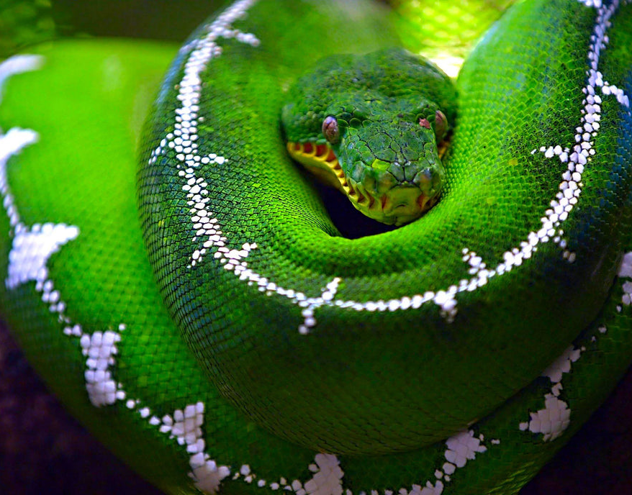
Impacts on Wildlife
Significant Habitat Destruction – Yes/No
Protection of Endangered Species - Yes/No
Protection and Regulation of Hunted Animals – Yes/No
Population Decline – Yes/No
30% of animal species in the reserve are classified as rare and endangered.

Slide 10
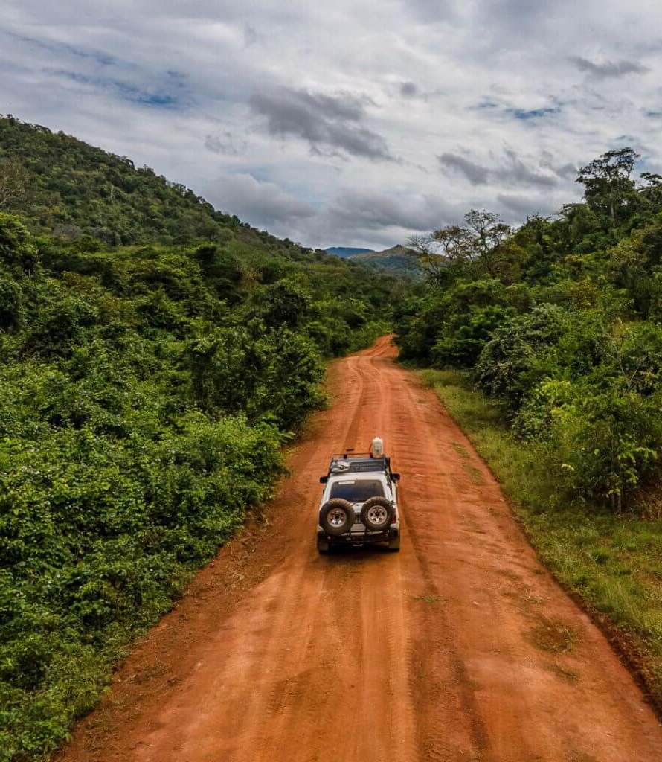
Climate Change Mitigation
Presence of Carbon Offset Initiatives – Yes/No/In Development
Creation of Green or Alternative Transit Options – Yes/No
Ecological Education Programs – Yes/No
Disaster Preparedness Plan – Yes/No

Slide 11
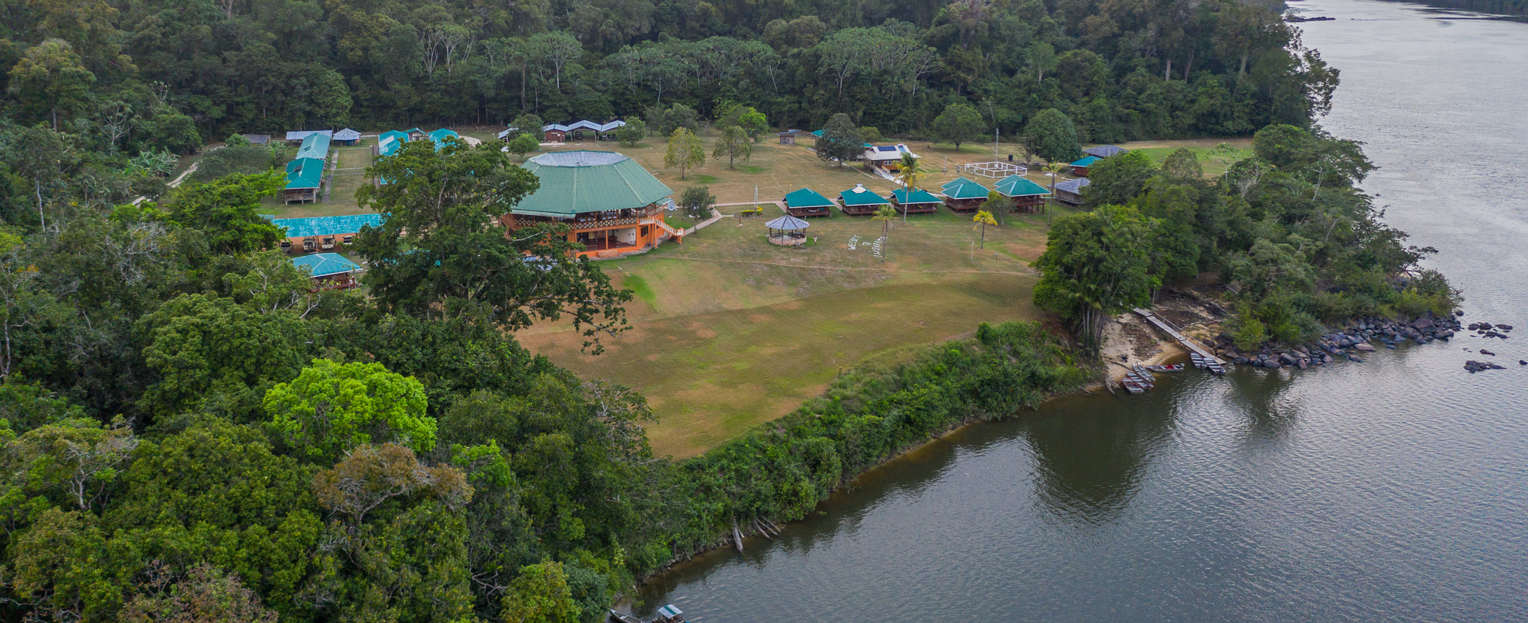
Energy, Waste, Water
Energy Usage – Low/Med/High
Implementation of Energy Saving Tech (Solar) – Yes/No
Degree of Water Usage – Low/Med/High
Initiatives for Saving Water – Yes/No
Evidence of Waste Reduction Measures – Yes/No
Water Quality Measured – Yes/No

Slide 12
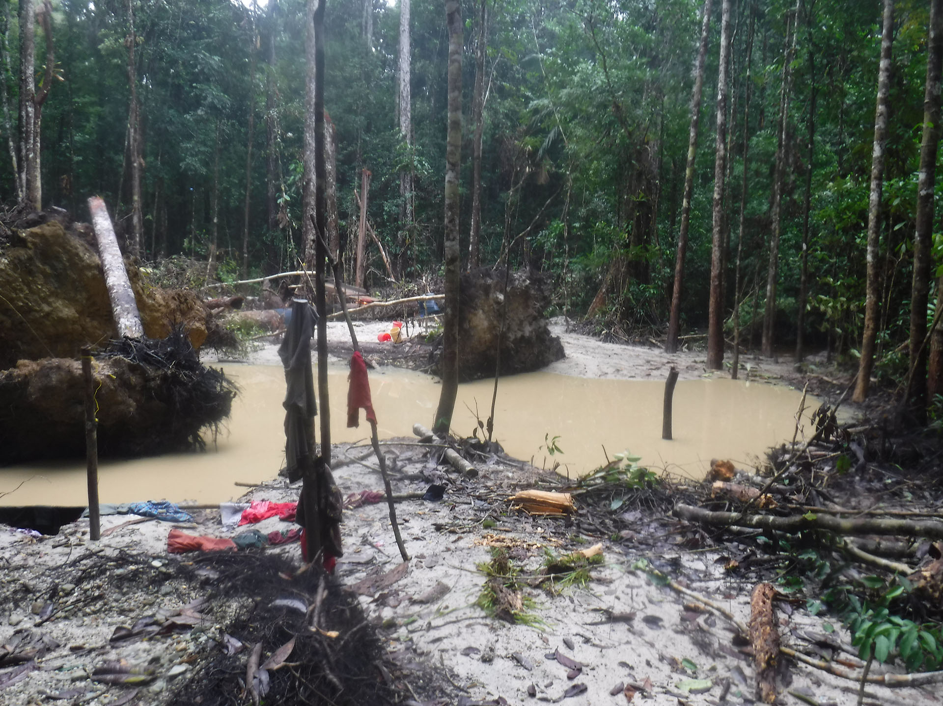
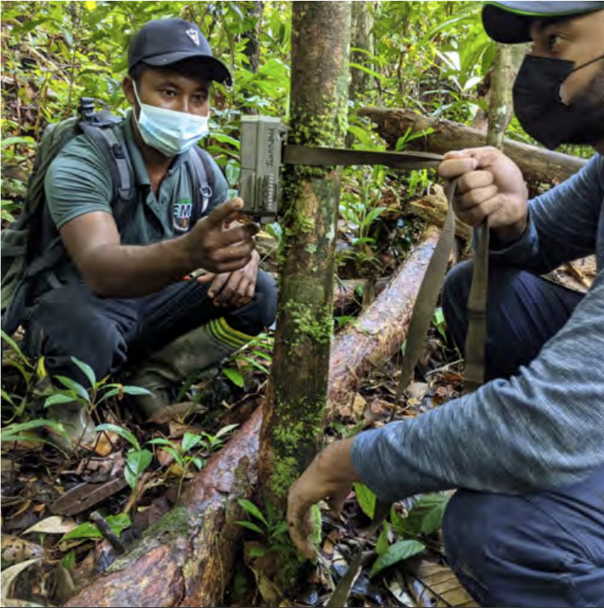
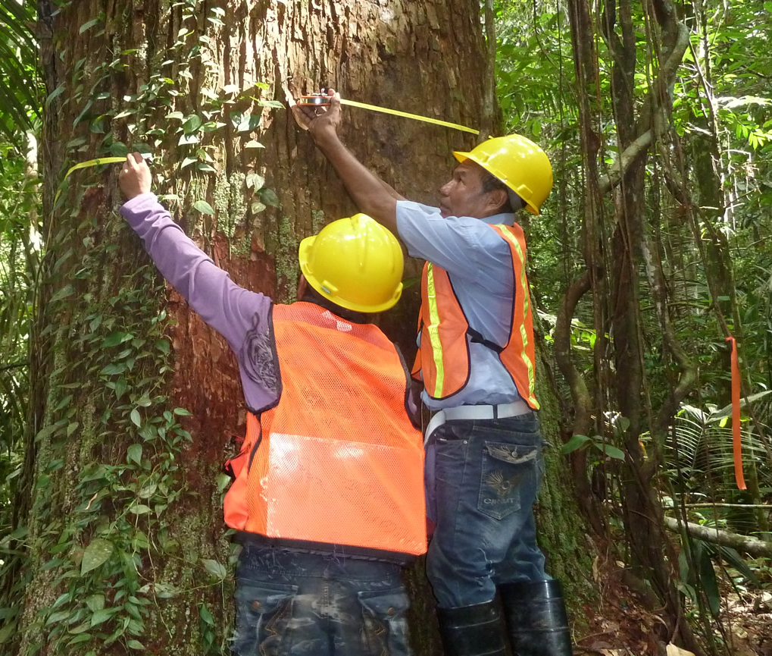
Biodiversity Conservation
Illegal Mining →
Policies for Biodiversity & Forestry Maintenance – Yes/No
Invasive Species Management Plan – Yes/No
Cooperation with Local Conservation Authorities – Yes/No
Investment in Conservation Efforts – FSC Certification, RIL Logging
Protected Areas – The reserve is 1/5 entirely protected in Guyana

Slide 13
Environmental Sustainability Rating
 | Unsatisfactory
 | Marginal
 | Needs Improvement
 | Improving Slightly
☑️ | Improving Well
 | Satisfactory

Slide 14
4.2 Economic

Slide 15
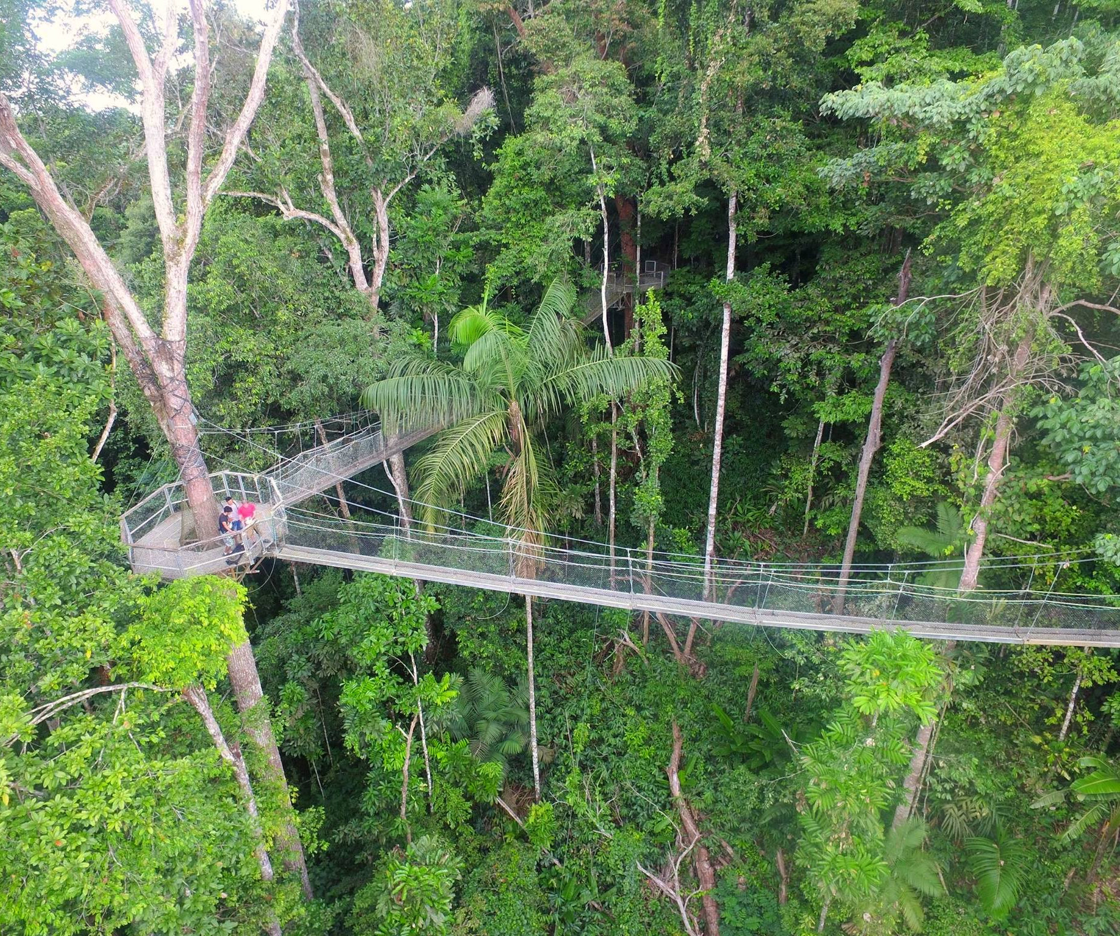
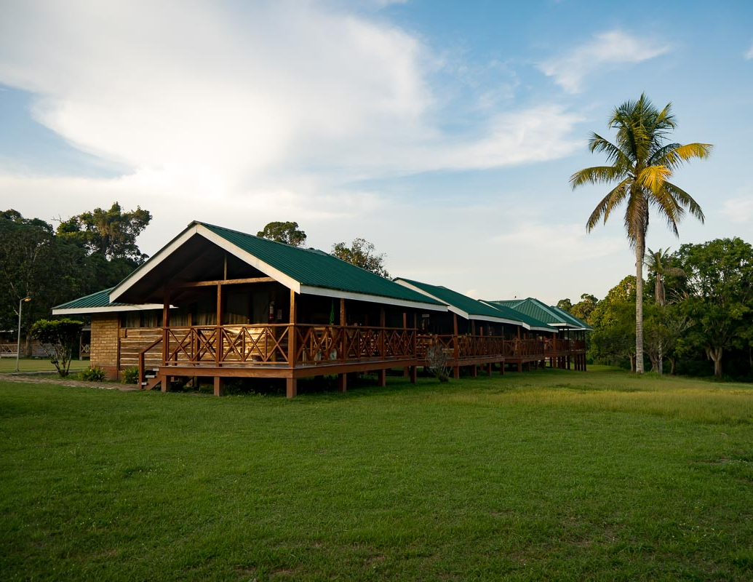
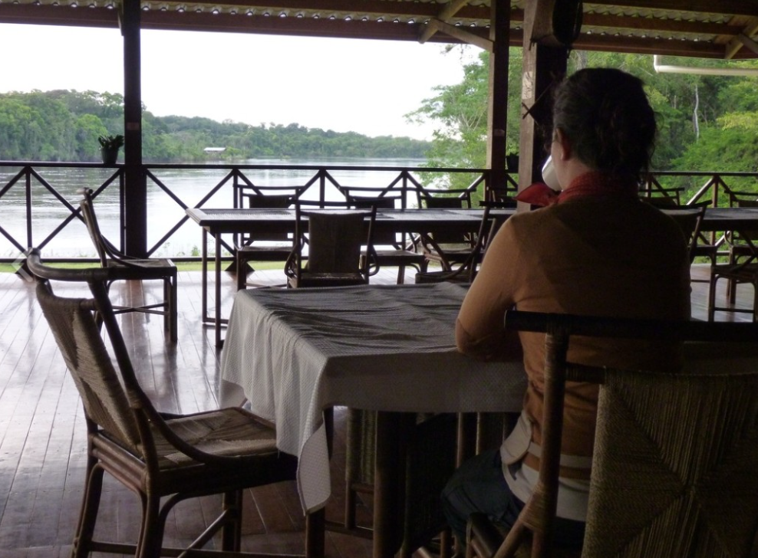
Economic – Local Economic Monitoring
Level of Tourism Employment – Yes/No
Supporting Local Entrepreneurs - Yes/No
Levels of Visitation – 92% increase (2021➡️ 2022)
Visitor Expenditure - Low/Medium/High
Tourism Revenue – Low/Medium/High
Tourism Revenue Leakage – Low/Med/High
Property Ownership – Local/Foreign/Both
Share of Employment Income from Tourism Industry – Yes/No

Slide 16
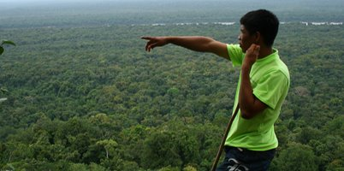
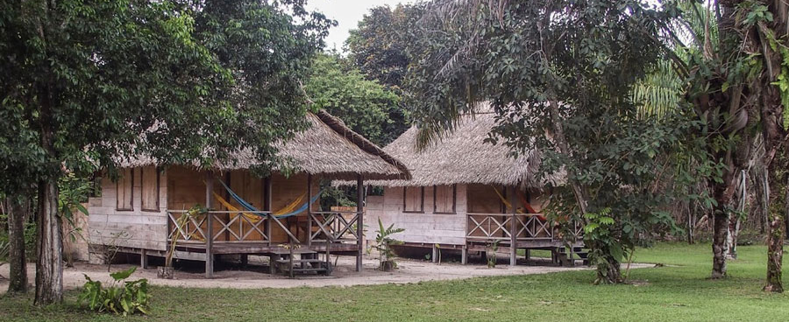
Economic – Sustainable Business Practices
Encouraging and Fostering Sustainable Enterprise - Yes/No
Publication of Certified Enterprises – Yes/No
Incentivization of Sustainable Practice- Yes/No
Use of Local Products and Services – Yes/No
Sustainably Sourced Products – Yes/No

Slide 17
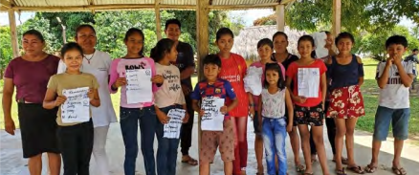
Economic – Optimization of Tourism Benefits
Equal and Fair Employment – Yes/No
Living/Fair Wage – Yes/No & Low/Medium/High
Diversified Tourism Activities- Low/Medium/High
Sharing Scheme for Tourism Revenues- Yes/No
Infrastructure Investment – Low/Medium/High

Slide 18
Economic Sustainability Rating
 | Unsatisfactory
 | Marginal
 | Needs Improvement
 | Improving Slightly
☑️ | Improving Well
 | Satisfactory

Slide 19
4.3 Political/Institutional

Slide 20
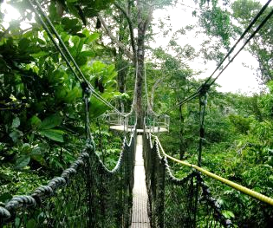
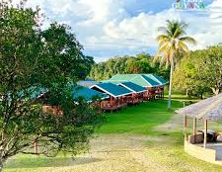
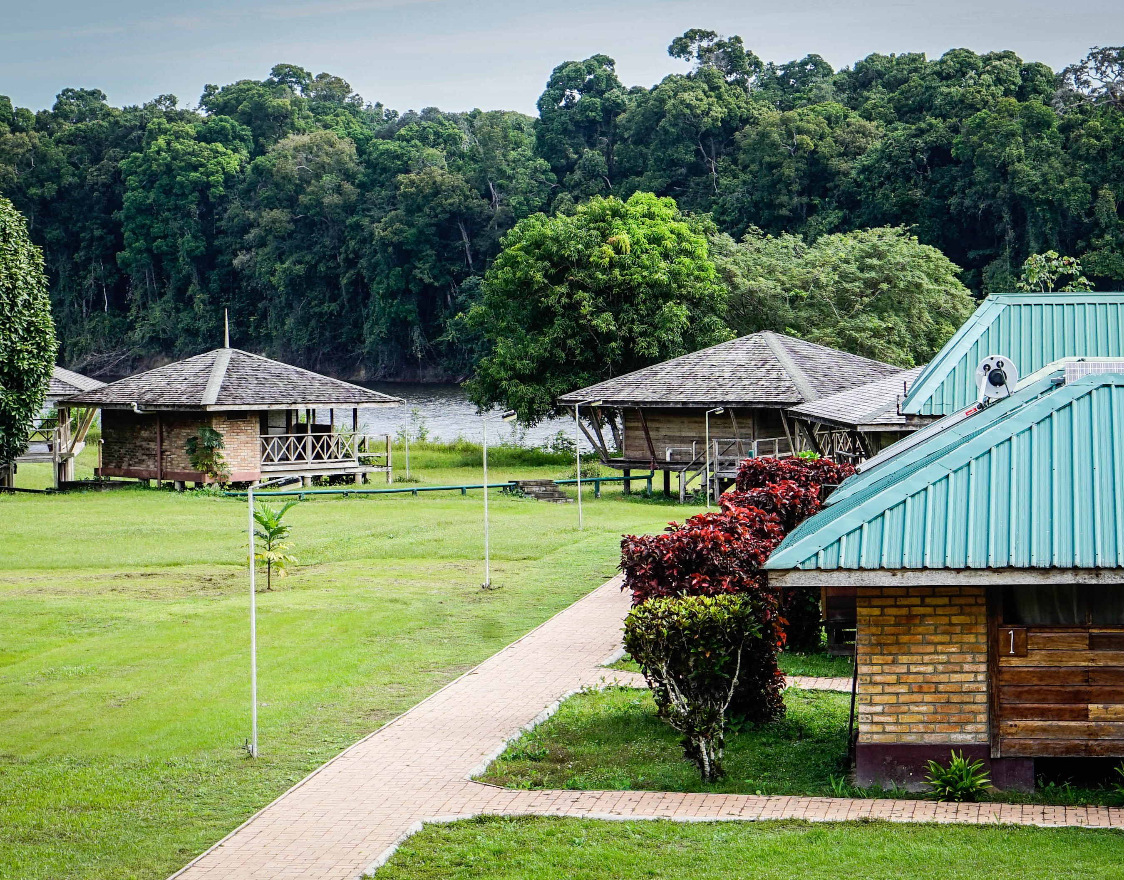
Institutional/Political ​ Initiatives Supporting ​ Sustainable Tourism​
​
Visitor Satisfaction Reporting and Surveying: Yes/No​
Presence of Demand Management Authority: Yes/No​
Published Tourism Strategy: Yes/No High/Medium/Low
Compliance with Environmental Standards: Yes/No​
Destination-Specific Programs Encouraging Local Tourism: Yes/No​
Adherence to Pollution Control Regulations: Yes/No​

Slide 21
Institutional/Political - Collaboration & Stakeholder Engagement
Research and Sourcing out Local Knowledge: Yes/No
High/Medium/Low
Integration of Traditional Indigenous Knowledge into Tourism Policies: Yes/No

Slide 22
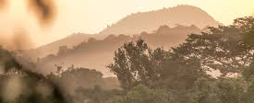
Institutional/Political - Transparency, Accessibility & Enforcement
Making Tourism Information Publicly Available: Yes/No
Public Education: Yes/No
Methods for Enforcing Tourism Policies or Laws: Yes/No
High/Medium/Low

Slide 23
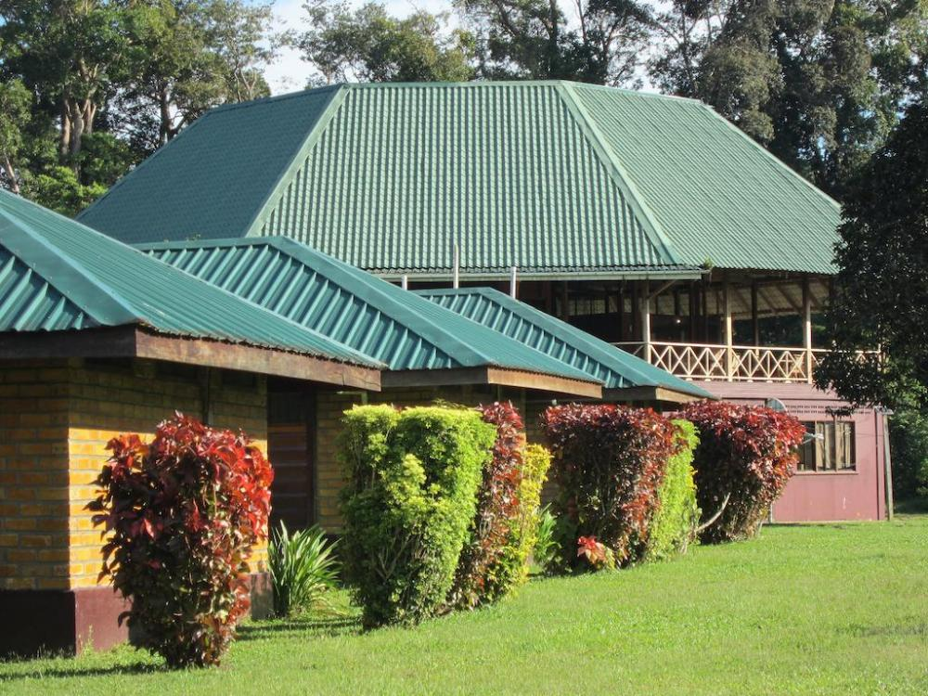
Institutional/Political - Sustainable Partnerships
Community Group or Leader Spearheading Sustainable Tourism: Yes/No
Involvement of Non-Governmental Organizations (NGOs) or Associated Agencies at Destination: Yes/No
High/Medium/Low
*Iwokrama River Lodge works with Environmental Management Consultants, and other associations

Slide 24
Institutional/ Political Rating
 | Unsatisfactory
 | Marginal
 | Needs Improvement
 | Improving Slightly
☑️ | Improving Well
 | Satisfactory

Slide 25
4.4 Social

Slide 26
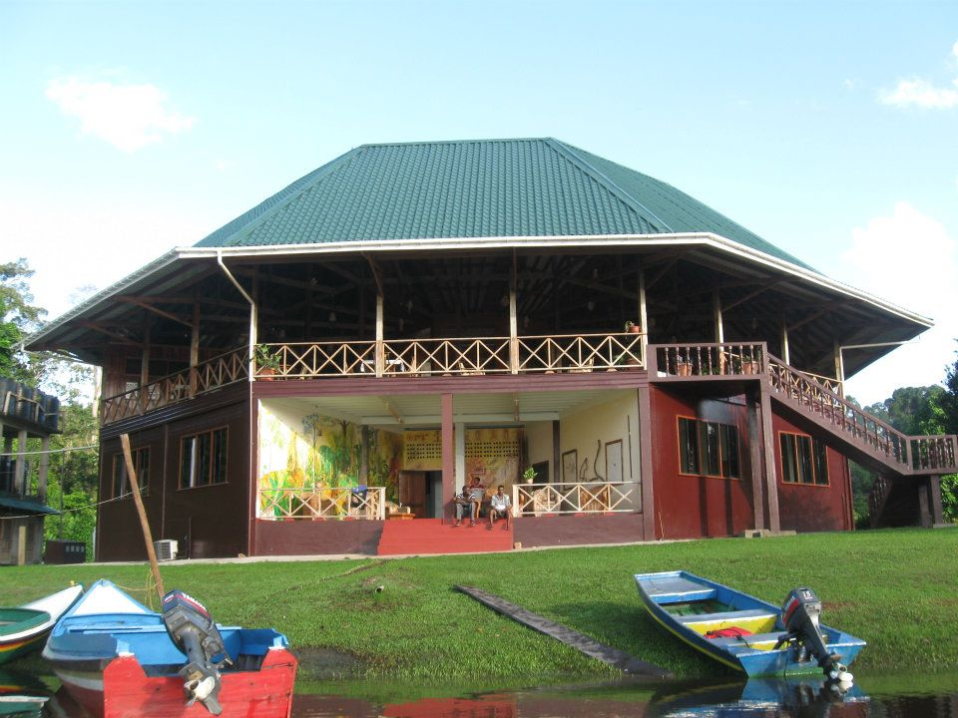
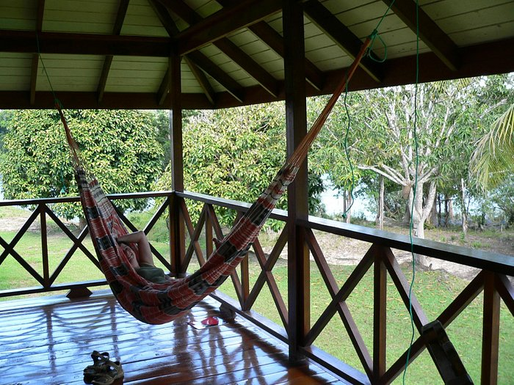
Social - Access to Opportunities
Adequate Access to Healthcare: Yes/No
Access to Different Levels of Education: Yes/No
Abundance of Career Opportunities: Yes/No

Slide 27
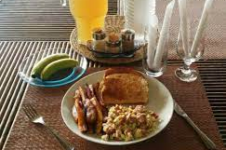
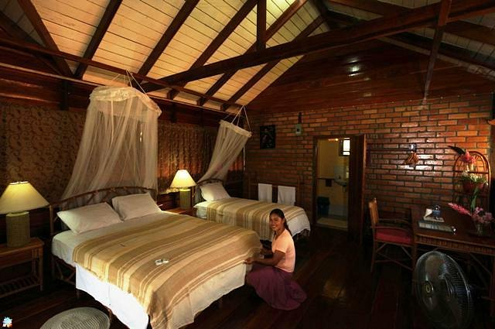
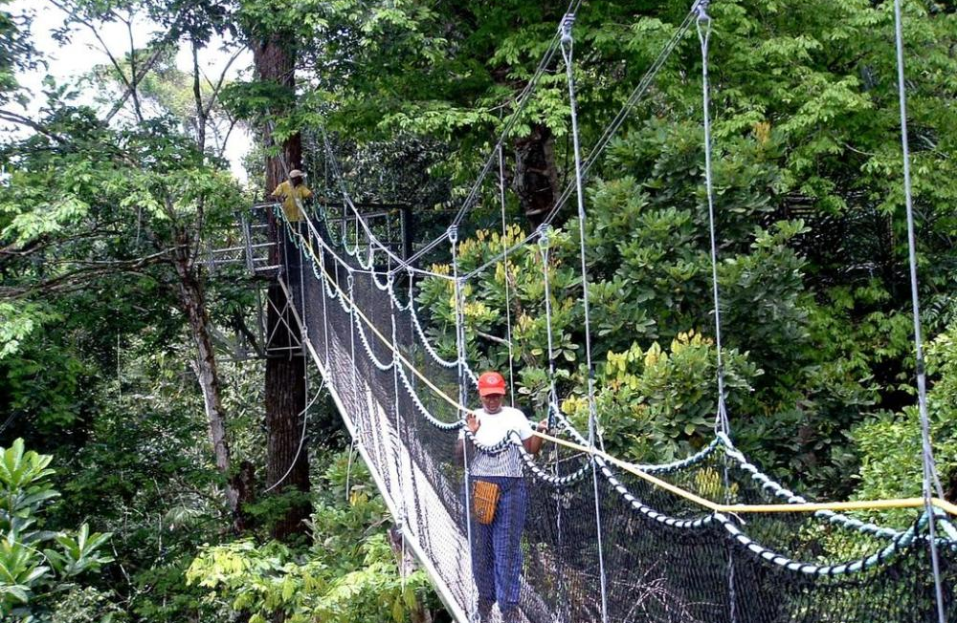
Social - Human Welfare
Adequate Living and Housing Conditions: Great/Adequate/Poor
Promoting Local Products and Services: Yes/No
Access to Clean Water and Nutritious Food: Great/Adequate/Poor
Physical Accessibility of Destination: Great/Adequate/Poor
Identity and Gender-Based Equity: Great/Adequate/Poor
Empowerment and Subjective Well-Being: Yes/No

Slide 28
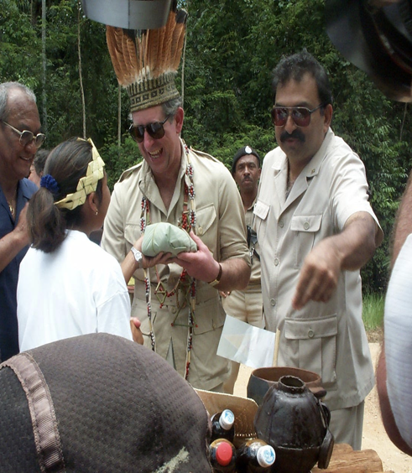
Social - Safety
Crime Prevention and Surveillance: Yes/No
Risk of Natural Disaster or Extreme Weather: High/Medium/Low

Slide 29
Social Sustainability Rating
 | Unsatisfactory
 | Marginal
 | Needs Improvement
 | Improving Slightly
☑️ | Improving Well
 | Satisfactory

Slide 30
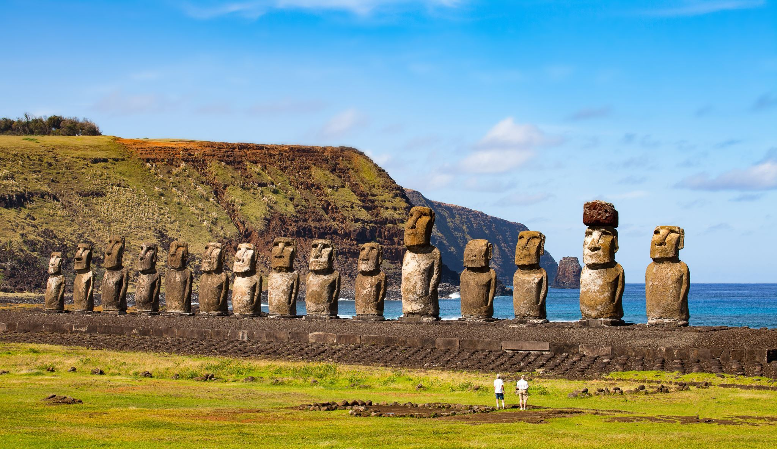
4.5 Cultural

Slide 31
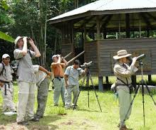
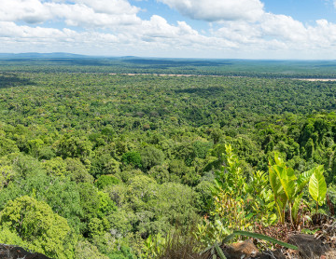
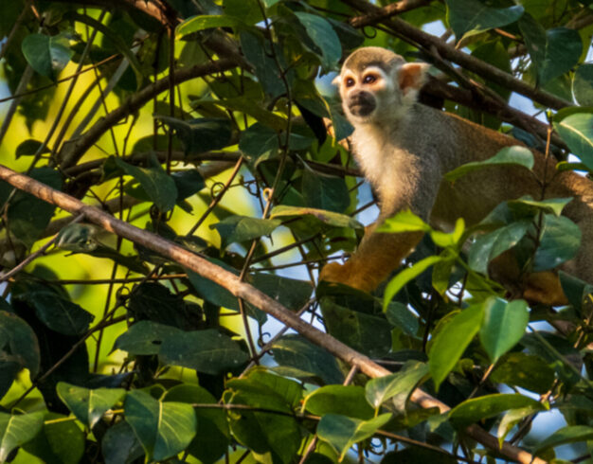
Cultural - Heritage Conservation & Sense of Place
Preservation of Indigenous Traditions: Yes/No
Interpretive Information: Yes/No
Offering of Authentic Cultural Tourism Experiences: Yes/No
Preservation of Cultural Heritage Sites: Yes/No
Presence of Heritage Conservation Regulation: High/Medium/Low

Slide 32
Cultural Sustainability Rating
 | Unsatisfactory
 | Marginal
 | Needs Improvement
 | Improving Slightly
 | Improving Well
☑️ | Satisfactory

Slide 33
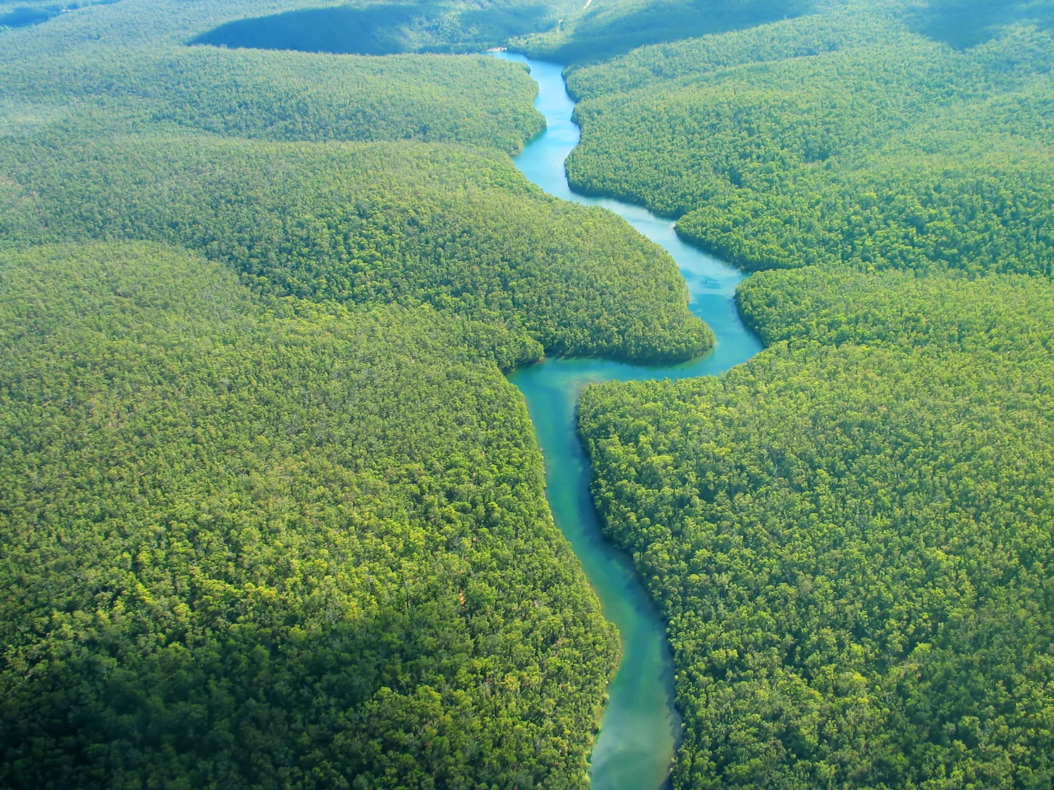
Sustainability Ratings
Environmental:
Economic:
Institutional
/Political:
Social:
Cultural:
 |  |  |  | ☑️
 |  |  |  | ☑️
 |  |  |  | ☑️
 |  |  |  | ☑️
 |  |  |  |  | ☑️

Slide 34
Overall Rating
 |  |  |  | ☑️

Slide 35
Limitations
Online resources provided limited qualitative information for evaluating specific indicators for the Pillar of Sustainability of Institutional, and Political related to Iwokrama River Lodge.

Slide 36
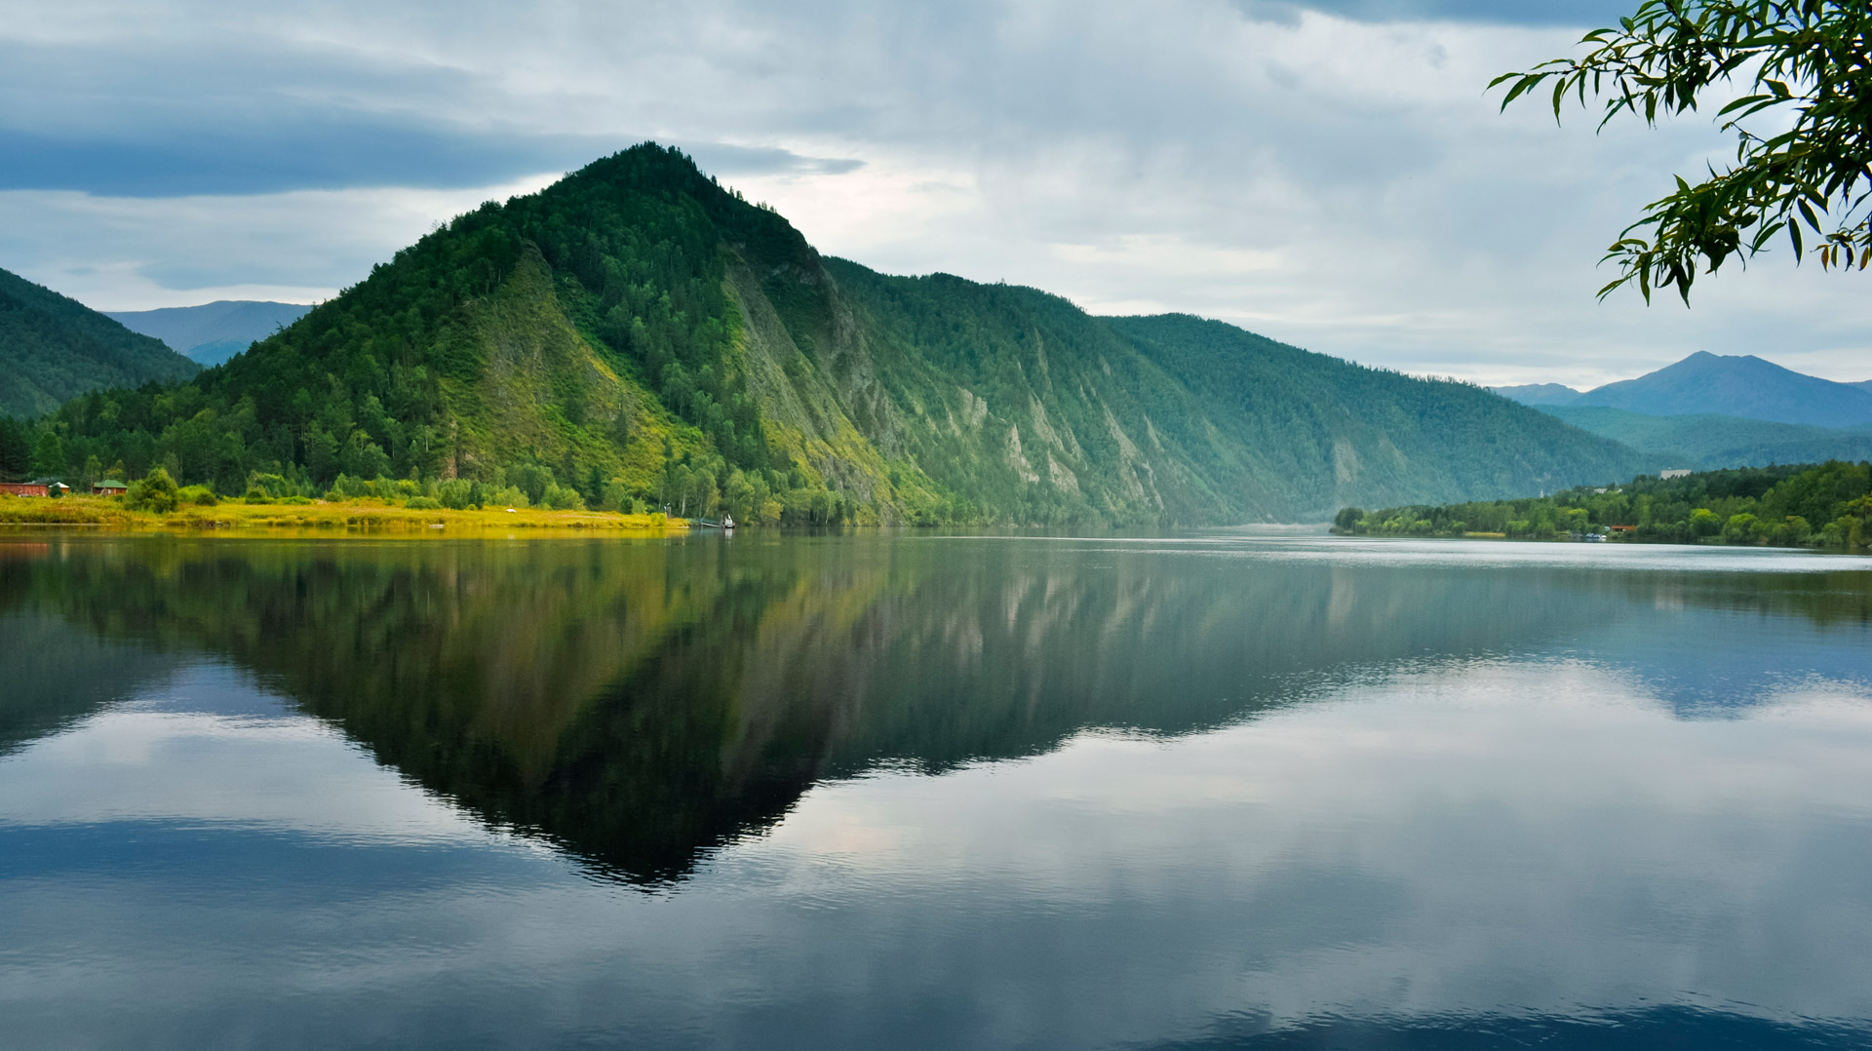
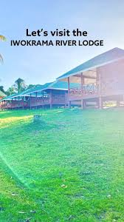
Thank You for Listening!

Slide 37
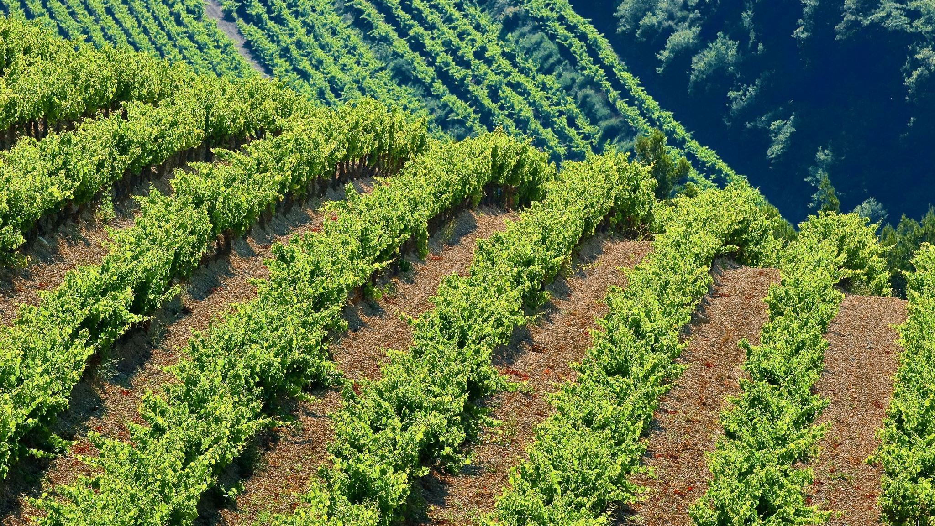
References (Environment)
“ACTO – Wildlife Management Plans – Iwokrama International Centre.” Iwokrama.org, 2023, iwokrama.org/library-and-archive/publications/acto-management-plan-public-review/. Accessed 25 Feb. 2024.
“Location--Iwokrama River Lodge.” Iwokramariverlodge.com, 2022, iwokramariverlodge.com/location/. Accessed 25 Feb. 2024.
“Mammals of Iwokrama--Iwokrama River Lodge.” Iwokramariverlodge.com, 2022, iwokramariverlodge.com/nature/mammals-of-iwokrama/. Accessed 25 Feb. 2024.
“The Lodge--Iwokrama River Lodge.” Iwokramariverlodge.com, 2022, iwokramariverlodge.com/lodge/. Accessed 25 Feb. 2024.
Environmental Protection Agency (EPA), Guyana. (2011). Guyana National Strategy on Invasive Alien Species [PDF file]. Retrieved from https://www.cabi.org/Uploads/isc/caribbean-legislation/BEAP-IAS-guyana-national-strategy-nov-2011.pdf

Slide 38
References (Environment Contd.)
Gaworecki, Mike. “Big Animals Can Survive Reduced-Impact Logging — If Done Right.” Mongabay Environmental News, 22 May 2017, news.mongabay.com/2017/05/big-animals-can-survive-reduced-impact-logging-if-done-right/. Accessed 25 Feb. 2024.
Harris, Arianne E, et al. “Use of Logging Roads by Terrestrial Mammals in a Responsibly Managed Neotropical Rainforest in Guyana.” Forest Ecology and Management, vol. 548, 1 Nov. 2023, pp. 121401–121401, www.sciencedirect.com/science/article/abs/pii/S0378112723006357?via%3Dihub, https://doi.org/10.1016/j.foreco.2023.121401. Accessed 25 Feb. 2024.
Iwokrama International Centre for Rainforest Conservation and Development. (2017). Iwokrama Overview Profile [PDF file]. Retrieved from https://iwokrama.org/wp-content/uploads/2017/05/Iwokrama_Overview_Profile.pdf
Iwokrama International Centre for Rainforest Conservation and Development. (2023). Annual Report 2022 [PDF file]. Retrieved from https://iwokrama.org/wp-content/uploads/2023/03/AR_2022sml.pdf
Iwokrama International Centre for Rainforest Conservation and Development. (2023). Public Summary: Forest Management & Monitoring [PDF file]. Retrieved from https://iwokrama.org/wp-content/uploads/2023/07/Public_Summary_June_23_Final2.pdf

Slide 39
References (Economic)
Guyanagy. (2021, February 9). The Iwokrama River Lodge, Region 8. Guyana-South America. https://guyanasouthamerica.gy/photos/2021/02/09/the-iwokrama-river-lodge-region-8/
Iwokrama. (2016, June 16). Iwokrama Overview Profile. Iwokrama. https://iwokrama.org/wp-content/uploads/2017/05/Iwokrama_Overview_Profile.pdf
Iwokrama. (2023, June 7). PUBLIC SUMMARY: FOREST MANAGEMENT & MONITORING. Iwokrama. https://iwokrama.org/wp-content/uploads/2023/07/Public_Summary_June_23_Final2.pdf
Iwokrama. (2022). Annual Report 2022. Iwokrama. https://iwokrama.org/wp-content/uploads/2023/03/AR_2022sml.pdf
Iwokrama. (2019). Annual Report 2019. Iwokrama. https://www.dropbox.com/s/ah2kqthasaxy940/Annual%20Report%202019%20Final%20Secure.pdf?e=2&dl=0
Iwokrama International Centre. (1998). Iwokrama International Centre for Rainforest Conversation and Development Act. Iwokrama Internation Centre. https://www.pac.gov.gy/wp-content/uploads/2022/10/Iwokrama-Act-1996.pdf

Slide 40
References (Economic Contd.)
Kamrul Baksh. (2022). Protection of the Natural and Scenic Views of the Iwokrama, Forest through Conservation and Rigorous Monitoring Plan and Activities. Top 100 Green Destinations. https://www.greendestinations.org/wp-content/uploads/2022/11/Iwokrama-Protection-of-the-Natural-and-Scenic-Views-of-the-Iwokrama-Forest-through-Conservation-and-Rigorous-Monitoring-Plan-and-Activities.pdf
Norway’s International Climate and Forest Initiative. (n,d.). Facts about Guyana. Norwegian Foreign of Climate and Environment. https://www.nicfi.no/partner-countries/guyana/#facts-about-guyana
R. Bushell, P. Eagles. (2007). Tourism and Protected Areas: Benefits Beyond Boundaries: the Vth IUCN World Parks Congress. World Conservation Union (IUCN).

Slide 41
References (Institutional/Political)
Harris, A.-E., Hallett, M., Davis, M., Carter, M., Singh, D., Roopsind, A., Maharaj, G., & Bicknell, J. (2023). Use of logging roads by terrestrial mammals in a responsibly managed neotropical rainforest in Guyana. Forest Ecology and Management, 548, 121401. https://doi.org/10.1016/j.foreco.2023.121401
Horsley, T., Bicknell, J., Lim, B., & Ammerman, L. (2015). Seed Dispersal by Frugivorous Bats in Central Guyana and a Description of Previously Unknown Plant-Animal Interactions. Acta Chiropterologica, 17, 331-336. https://doi.org/10.3161/15081109ACC2015.17.2.008
iNews Guyana. (2022, December 7). Iwokrama welcomes Guyana’s innovative Carbon Agreement. iNews Guyana. https://www.inewsguyana.com/iwokrama-welcomes-guyanas-innovative-carbon-agreement/
Iwokrama River Lodge. (n.d.). Survey dev. Iwokrama River Lodge. Retrieved February 24, 2024, from https://iwokramariverlodge.com/survey-dev/
Iwokrama International Centre for Rain Forest Conservation and Development. (2023). Iwokrama River Lodge and Research Centre. Retrieved February 24, 2024, from https://iwokrama.org/our-work/sustainable-tourism/iwokrama-river-lodge-and-research-centre/
Iwokrama International Centre for Rain Forest Conservation and Development. (2023). Annual Report 2022 [PDF]. Iwokrama. https://iwokrama.org/wp-content/uploads/2023/03/AR_2022sml.pdf

Slide 42
References (Institutional/Political Cont.)
Iwokrama International Centre for Rain Forest Conservation and Development. (2023). Public Summary June 2023 [PDF]. Iwokrama. https://iwokrama.org/wp-content/uploads/2023/07/Public_Summary_June_23_Final2.pdf
Iwokrama River Lodge. (n.d.). Iwokrama River Lodge. Retrieved February 24, 2024, from https://iwokrama-river-lodge.business.site
Iwokrama International Centre for Rain Forest Conservation and Development. (2014). Iwokrama Annual Report 2012-2013 [PDF]. https://iwokrama.org/wp-content/uploads/2014/05/Iwokrama-Annual-Report-2012-2013.pdf
Kok, P. J. R. (2011). A new species of the genus Gonatodes Fitzinger, 1843 (Reptilia: Sphaerodactylidae) from central Guyana, northern South America. Zootaxa, 3018(3018), 1-12. https://doi.org/10.11646/zootaxa.3018.1.1
N.D. Enjoy some pictures of the worldrecordtour, taken in Guyana - Part 2: Iwokrama. http://weltrekordreise.ch/p_amerise_gy2.html
Staff Reporter. (2015, June 20). Iwokrama River Lodge earns Certificate of Excellence from a popular American travel website. Guyana Chronicle. https://guyanachronicle.com/2015/06/20/iwokrama-river-lodge-earns-certificate-of-excellence-from-a-popular-american-travel-website/
Triplyzer. (2023). 30 Famous Landmarks in Guyana – you shouldn't be missing. Triplyzer. Retrieved from https://triplyzer.com/landmarks/south-america-landmarks/landmarks-in-guyana/

Slide 43
References (Social)
Adventure Life. (n.d.). Iwokrama River Lodge - stay in the heart of the Iwokrama Forest in Guyana. Retrieved from https://www.adventure-life.com/guyana/iwokrama-forest/hotels/iwokrama-river-lodge
Iwokrama International Centre. (2023, June). Public summary June 23. https://iwokrama.org/wp-content/uploads/2023/07/Public_Summary_June_23_Final2.pdf
Iwokrama International Centre. (2022). Annual Report 2022. https://iwokrama.org/wp-content/uploads/2023/03/AR_2022sml.pdf
Iwokrama International Centre. (n.d.). Iwokrama overview profile. https://iwokrama.org/wp-content/uploads/2017/05/Iwokrama_Overview_Profile.pdf
Iwokgrama International Centre for Rainforest Conservation & Development (2022). Iwokroma River Lodge. https://iwokramariverlodge.com/lodge/faq/
Journey Latin America. (n.d.). Iwokrama River Lodge and Research Centre - Guyana Accommodation. Retrieved from https://www.journeylatinamerica.com/destinations/guyana/places-to-visit/the-interior/places-to-stay/iwokrama-river-lodge-and-research-centre&#8203
Staff Reporter. (2019, March 24). Iwokrama’s eco-tourism. Guyana Chronicle. https://guyanachronicle.com/2019/03/24/iwokramas-eco-tourism/
Guyana Times. (2022, August 28). Indigenous community-led-and-owned tourism development in Guyana. https://guyanatimesgy.com/indigenous-community-led-and-owned-tourism-development-in-guyana/
Shepherd, P. (2023, November 4). Exploring Guyana. South America's Wild Frontier. TripReporter. https://www.tripreporter.co.uk/exploring-guyana-south-america/

