Slide 1
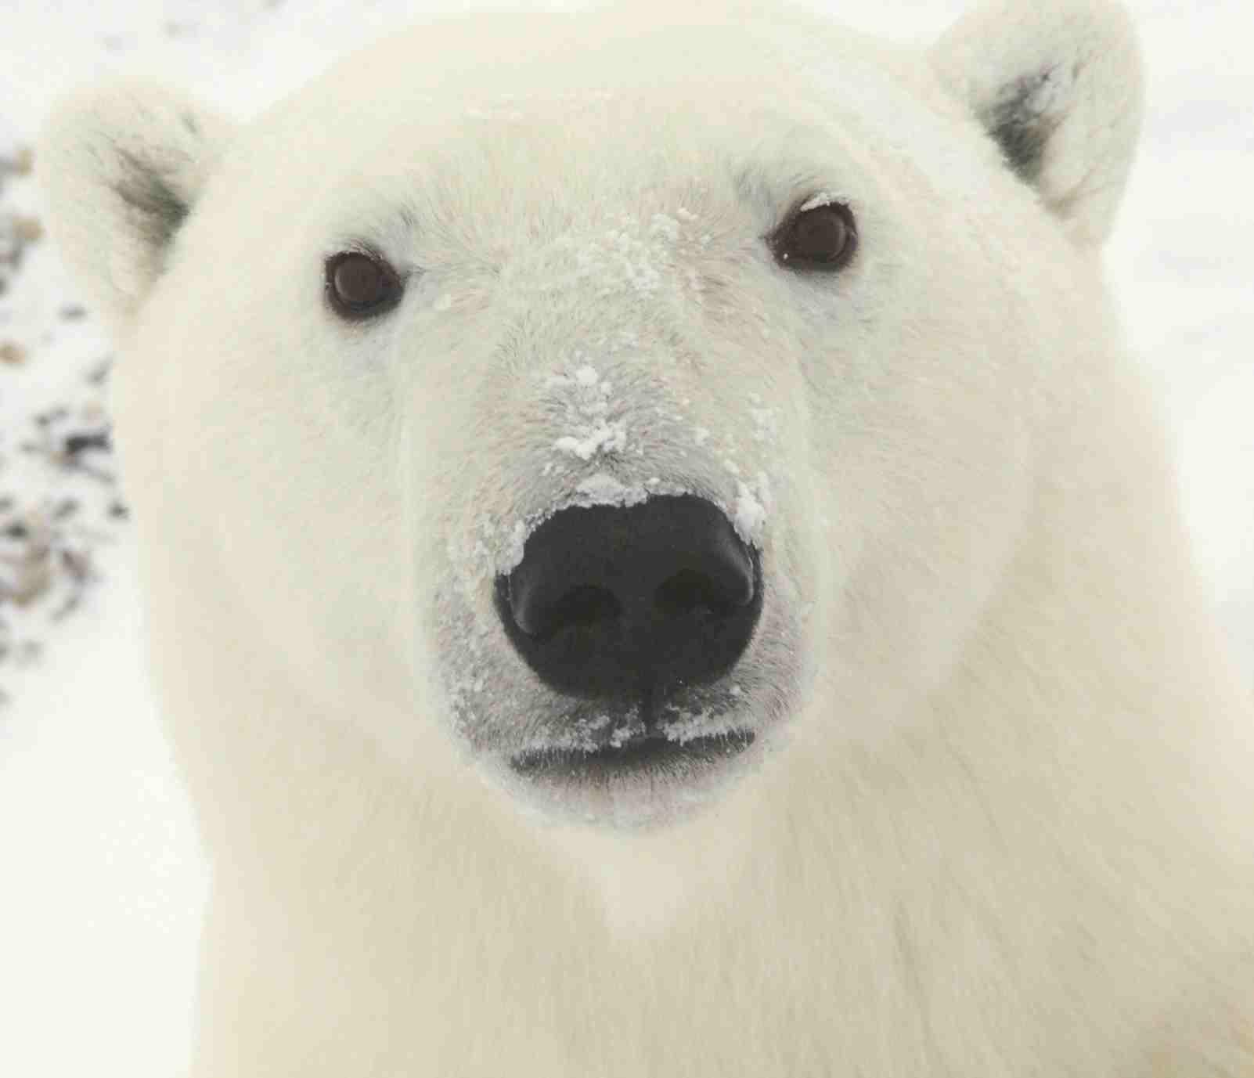
The Impact of
Sea Ice Change
on
the Polar Bear Population:
Research in M’Clintok Channel
and Baffin Bay
Zarrin Tasneem
image from http://upload.wikimedia.org/wikipedia/commons/f/f8/Polar_Bear_0319_-_23-11-06.jpg

Slide 2
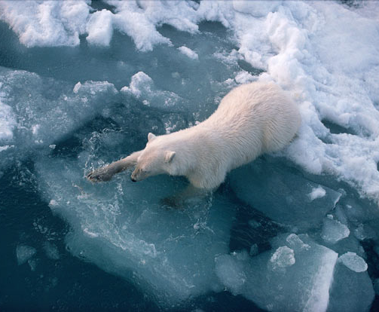
Introduction
Global population: 25,000 (60%-80% in Canada)
19 subpopulations (Polar bear status, distribution & population, n.d.)
Climate change → Sea ice → Polar bear population
Break-up/Freeze-up season: Hunting and storing energy
First-year ice & Landfast ice: High density, high productivity and easy access of ringed seals
Retrieved from http://www.telegraph.co.uk/news/picturegalleries/picturesoftheday/8045678/Pictures-of-the-day-6-October-2010.html?image=4

Slide 3
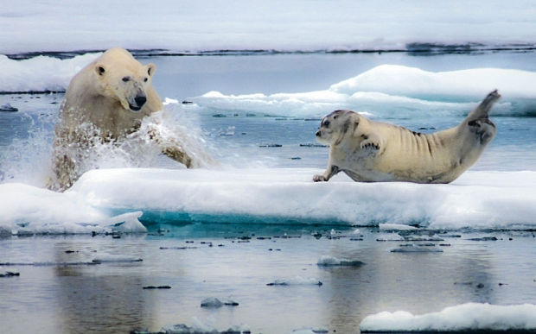
Introduction
Global population: 25,000 (60%-80% in Canada)
19 subpopulations (Polar bear status, distribution & population, n.d.)
Climate change → Sea ice → Polar bear population
Break-up/Freeze-up season: hunting and storing energy
First-year ice & Landfast ice: high density, high productivity and easy access of ringed seals
Retrieved from http://www.telegraph.co.uk/culture/tvandradio/tv-and-radio-reviews/11965287/The-Hunt-review.html

Slide 4
Objectives
Classify and isolate sea ice from other land cover types
(land, snow, water, clouds)
Identify break-up and freeze-up periods
(RADARSAT-1 & CIS Ice Chart)
Classify different sea ice types and determine the area of specific ice on break-up start date
(CIS Ice Chart & MODIS)
Polar bear population vs. sea ice change

Slide 5
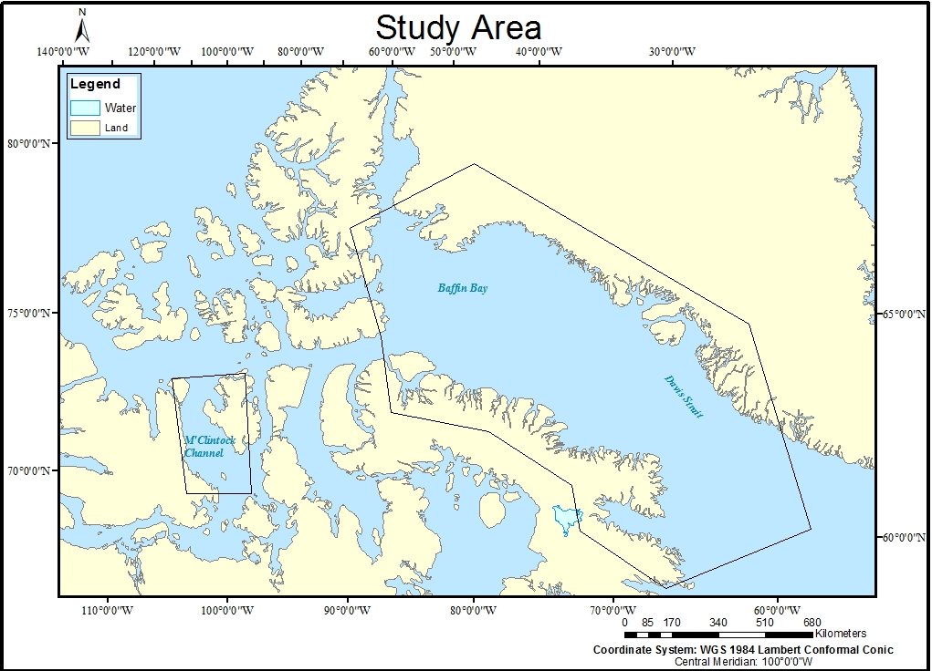
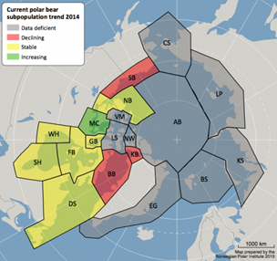
Study Area
 | Year | Population | Trend
Baffin Bay (75°15'49.7"N, 68°31'32.0"W) | 2004 | 1546±28 | Decrease
 | 2013 | 486
M’Clintock Channel (72°18'14.6"N, 104°47'18.2"W) | 2000 | 284±59.3 | Increase (predicted)
 | (2014-2016) | 122 (in 2004)
Retrieved fromhttp://www.polarbearsinternational.org/media/images/population-status-map-2014

Slide 6
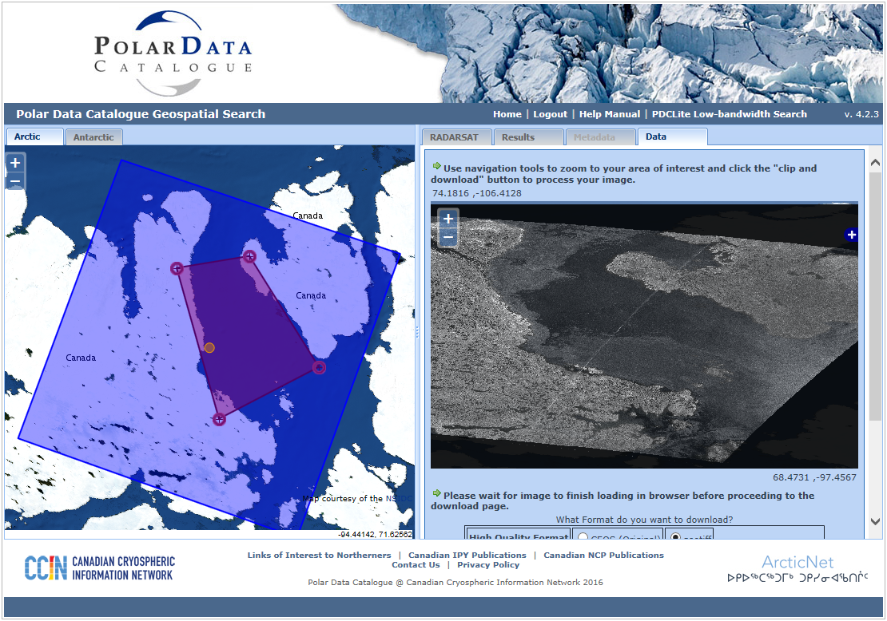
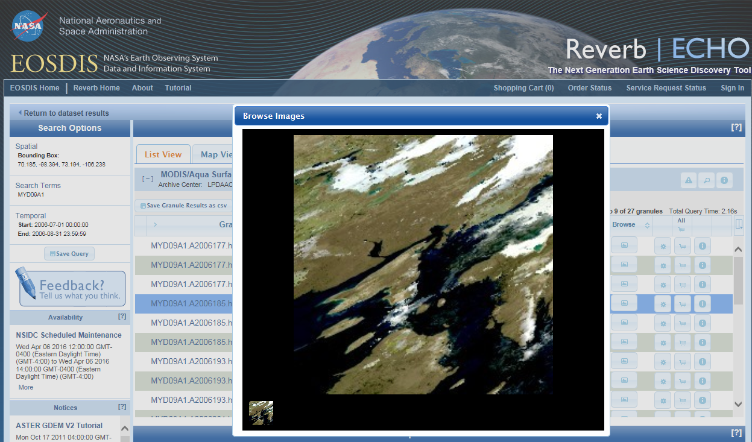
Data
RADARSAT-1 CIS Ice Chart MODIS (MYD09A1)
Dataset | Year | Band | Spatial Resolution | Advantage
RADARSAT-1 | 1995-2007 | C | 8-100m | (SAR) own microwave illumination; Frequent revisit period;
MODIS (MYD09A1) (Band 1,2 & 3 used) | 2000-Now | 1-7 | 500m | The best possible L2G observation; Absence of clouds or cloud shadow; Absence of atmospheric scattering or absorption;

Slide 7
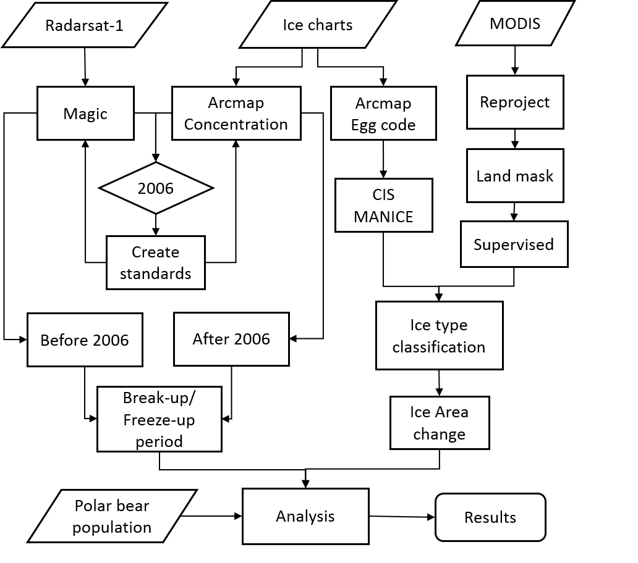
Methodology

Slide 8
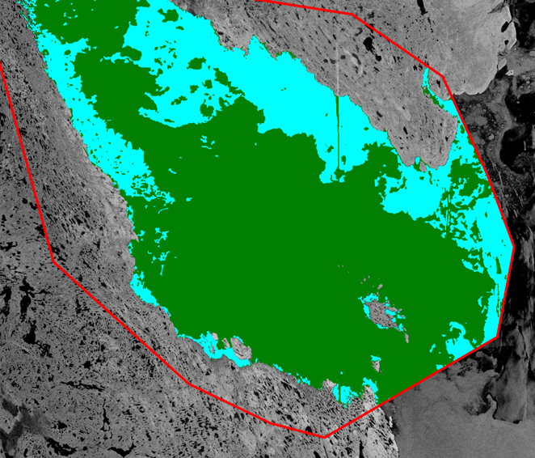
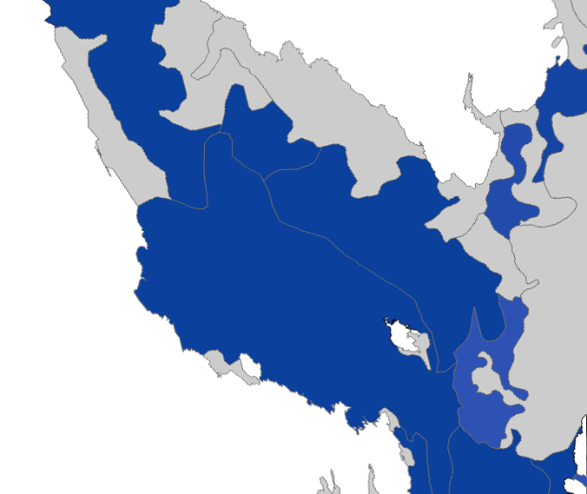
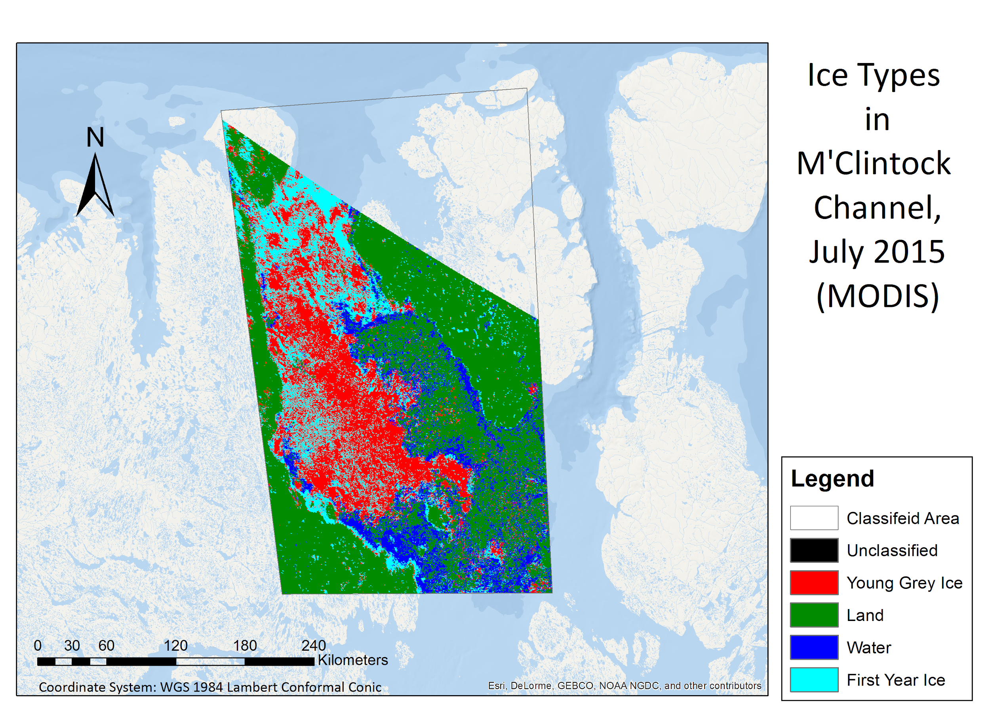
Methodology
-- Example (2006/08/03 M’Clintock Channel)
Ice
Water
>50%
<50%

Slide 9
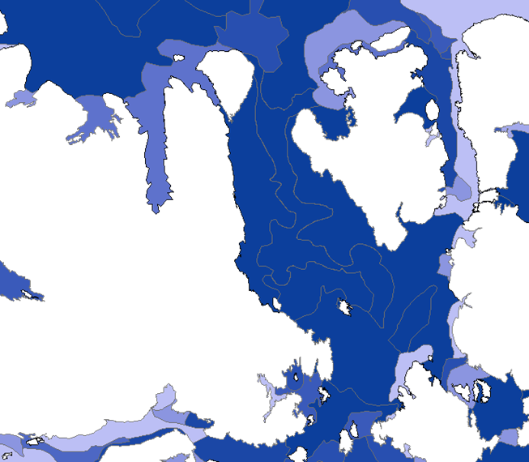
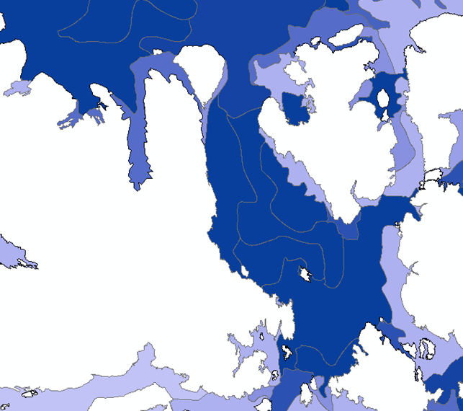
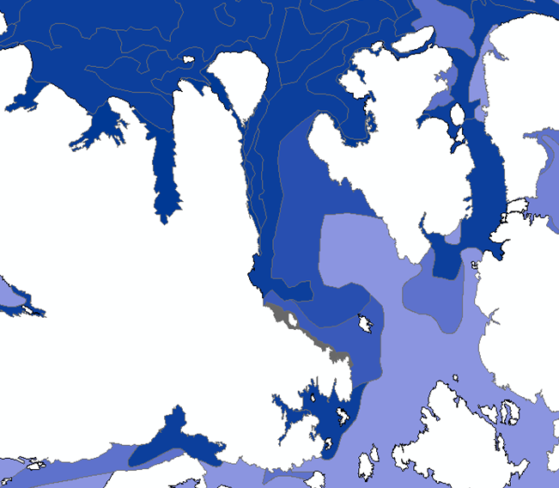
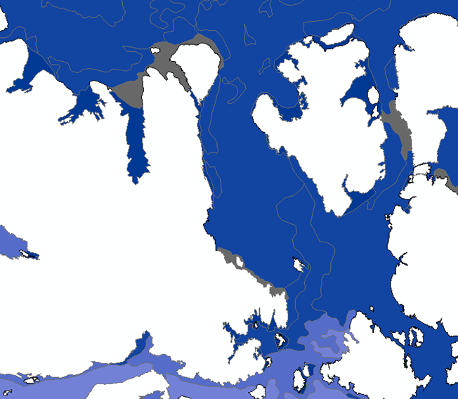
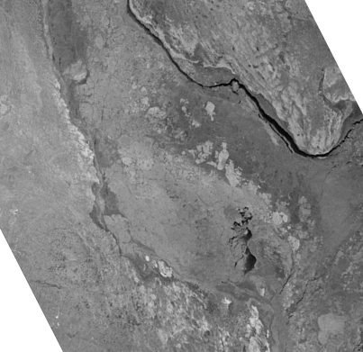
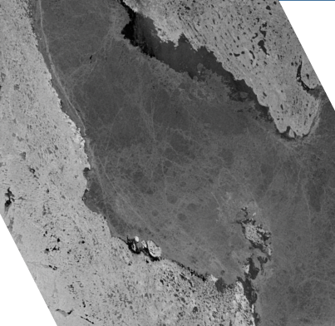
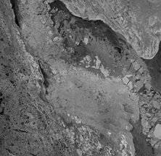
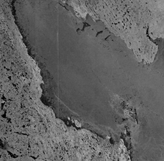
2007 MC Break-up Start 2007 MC Freeze-up Start
2003 MC Break-up Start 2003 MC Freeze-up Start

Slide 10
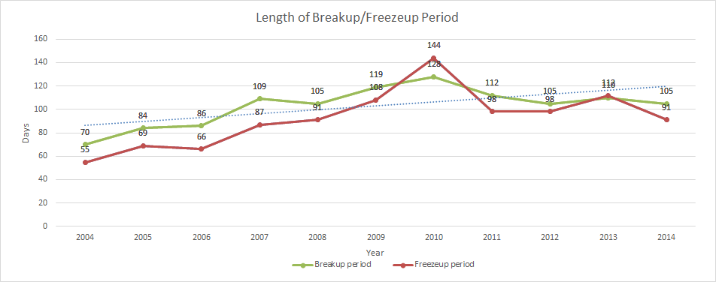
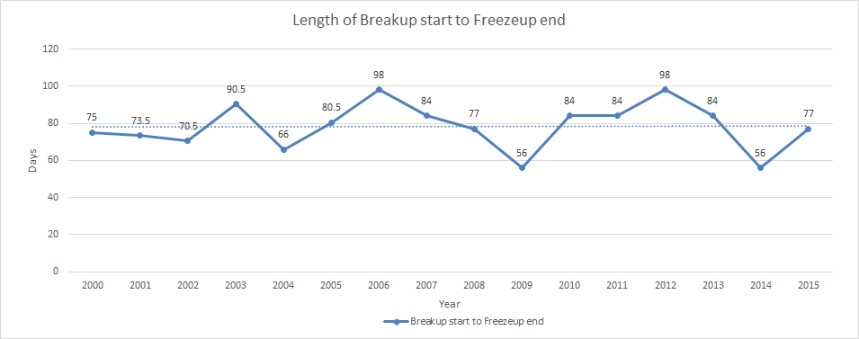
Results
Baffin Bay
M’Clintock Channel

Slide 11
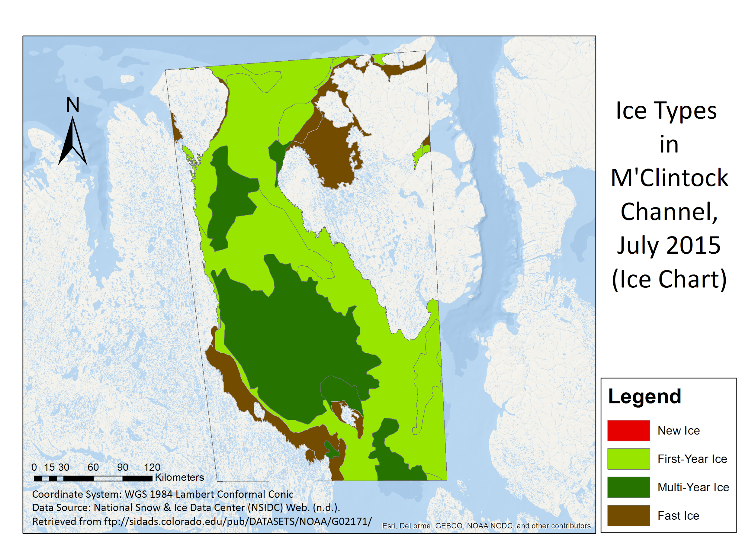
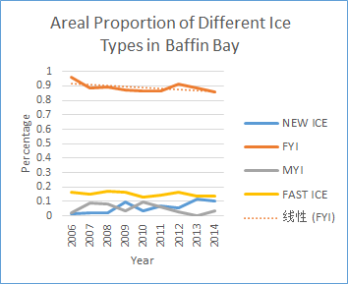
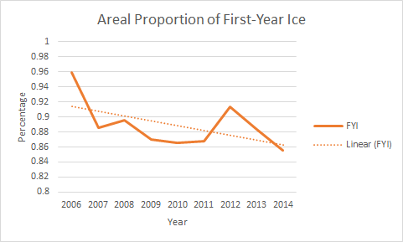
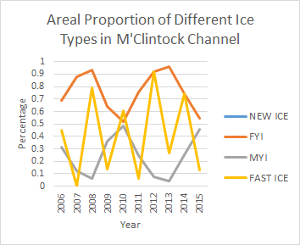
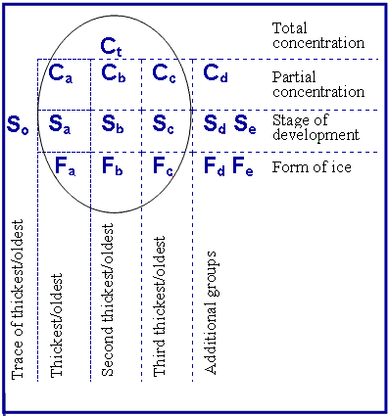
Methodology & Results
-- Classification and Calculation Based on CIS Ice Charts
concertation
stage of development
floe size code
CIS Ice-Code
Mapping
MANICE Description
Visualization
Calculation

Slide 12
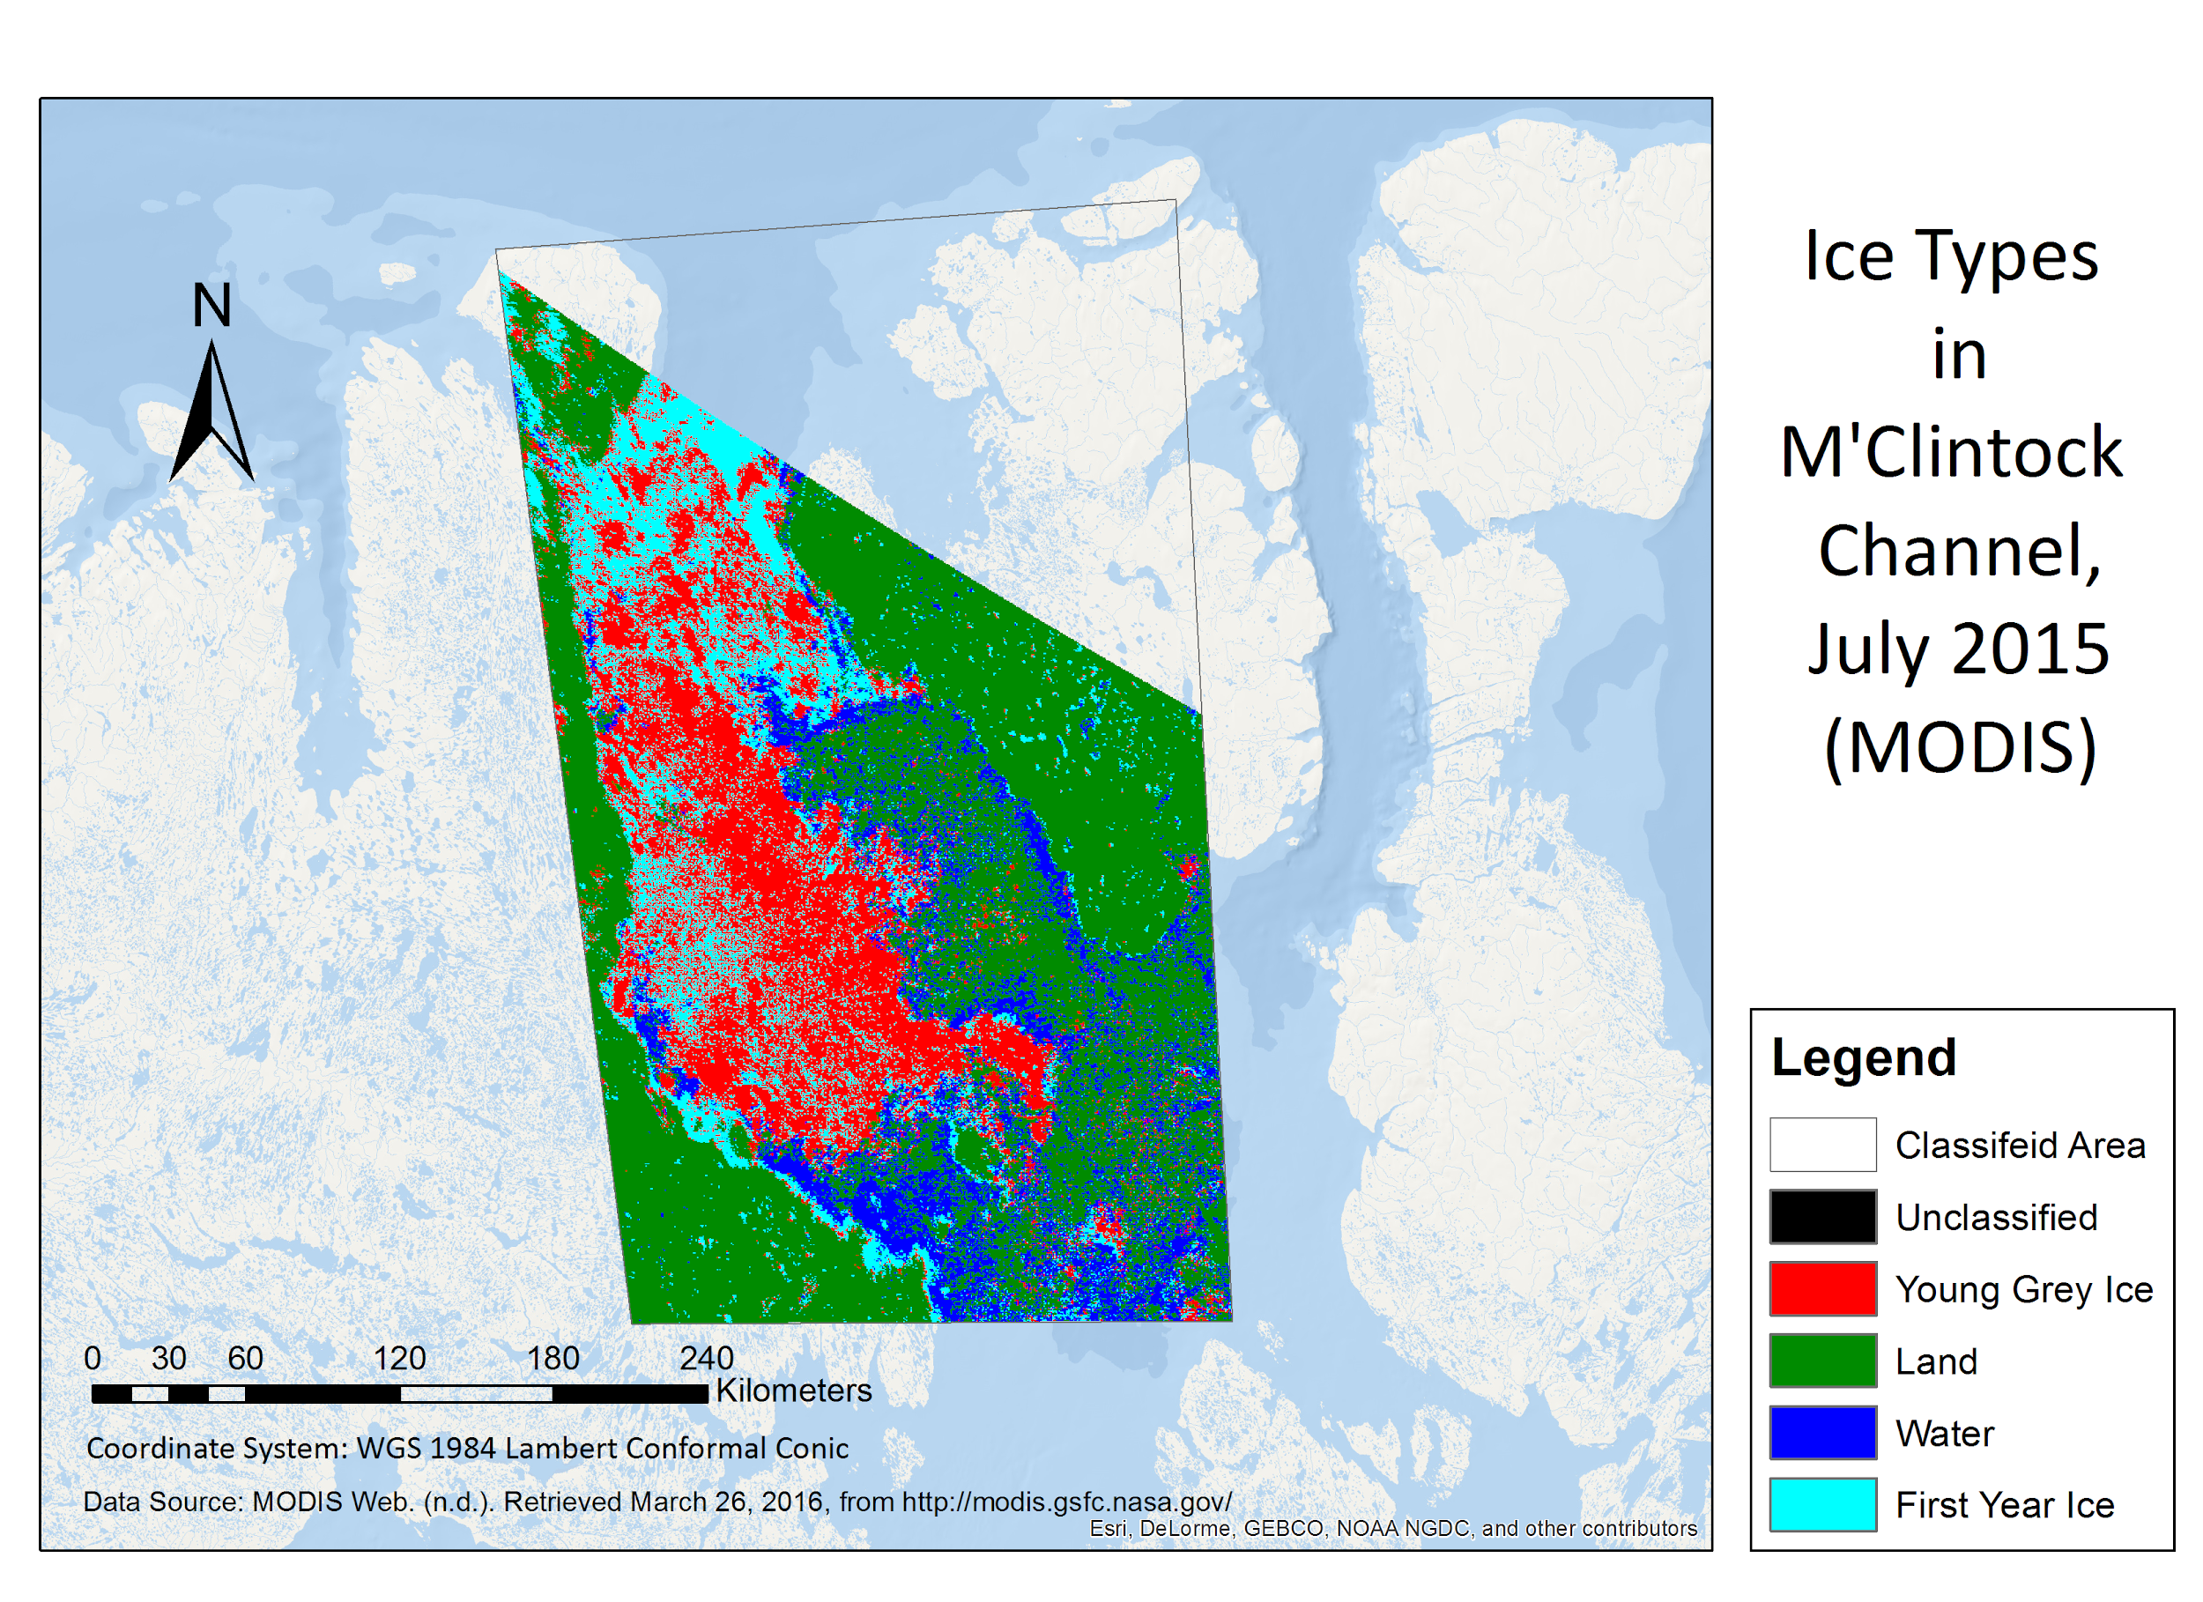
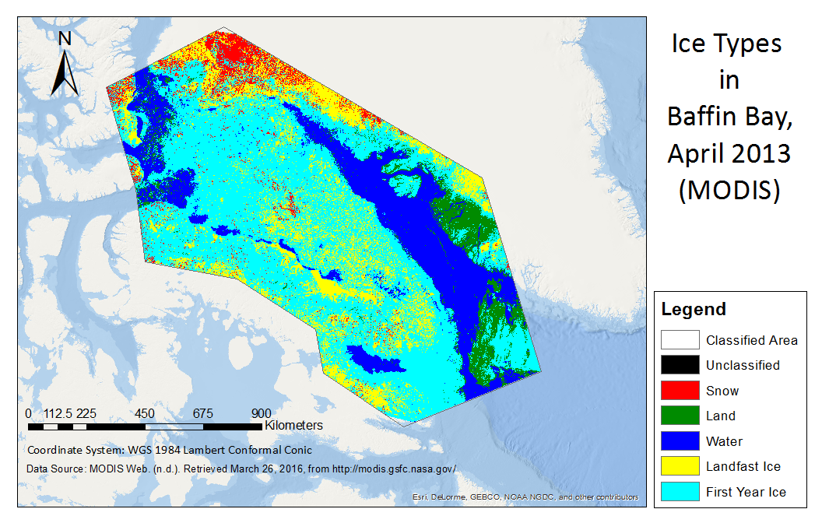
Methodology & Results
-- Maximum Likelihood Classification, based on reflectance values
-- Used MODIS images
Surface albedo for landfast ice: >0.8
NDSI Band math: (b4-b6)/(b4+b6)

Slide 13
Discussion
Break-up/Freeze-up period
(longer)
Benefit survival
Other factors
Baffin Bay
First-Year Ice (larger)
Fast Ice (stable)
Less suitable habitat
Decreasing population
Break-up/Freeze-up period
(stable)
Relatively stable environment
Migration
Increasing population
M’Clintock
Channel
First-Year Ice, Fast Ice
(no trend)

Slide 14
Conclusion
Key indicators.
Radarsat-1 and CIS ice charts & the break-up/freeze-up period.
Ice charts & calculation of ice type area.
Maximum Likelihood Classification & evaluation of ice type classification.
Decreasing population in Baffin Bay may be due to less first-year ice.
Increasing population in M’Clintock Channel may result from migration.

Slide 15
Hopefully, We Can All Take An Initiative To Reduce The Polar Bear Vulnerability
retrieved from: https://s-media-cache-ak0.pinimg.com/736x/9d/98/4d/9d984dc052722f0be657a86a80f9ac73.jpg

Slide 16
References
Atkinson, S. M. (2014). BAFFIN BAY POLAR BEAR GENETIC MARK RECAPTURE: INTERIM REPORT TO THE NUNAVUT WILDLIFE RESEARCH TRUST. Iqaluit: Government of Nunavut.
Barber, D. G. and I. (2004), Historical Analysis of Sea Ice Conditions in M'Clintock Channel and the Gulf of Boothia, Nunavut: Implications for Ringed Seal and Polar Bear Habitat, Arctic, 57(1), 1-14.
Campagna, L., Van Coeverden De Groot, Peter J, B. L. Saunders, S. N. Atkinson, D. S. Weber, M. G. Dyck, P. T. Boag, and S. C. Lougheed (2013), Extensive sampling of polar bears ( Ursus maritimus) in the Northwest Passage ( Canadian Arctic Archipelago) reveals population differentiation across multiple spatial and temporal scales, Ecology and evolution, 3(9), 3152, doi:10.1002/ece3.662.
(2008). Baffin Bay Polar Bear Population. Iqaluit: Department of Environment, Government of Nunavut. Retrieved from Nunavut Wildlife Management Board.
M. Dyck, M. H. (2015). ESTIMATING THE ABUNDANCE OF THE M’CLINTOCK CHANNEL POLAR BEAR SUB-POPULATION BY GENETIC MARK-RECAPTURE. Iqaluit: Department of Environment, Government of Nunavut.
MODIS Web. (n.d.). Retrieved March 26, 2016, from http://modis.gsfc.nasa.gov/
(n.d.). Retrieved March 28, 2016, from http://earthobservatory.nasa.gov/Features/SeaIce/images/sea_ice_polar_bear.jpg
Taylor, M. L. (2006). Demographic parameters and harvest-explicit population viability analysis for polar bears in M'Clintock Channel, Nunavut, Canada. The journal of Wildlife Management, 1667-1673.

